Slide 1
Top Down and Bottom Up
Fully Integrating Learning and Assessment Practices
www.ResearchNotRhetoric.com/rnr-talks.php
PPTs & Handouts: www.ResearchNotRhetoric.com/rnr-talks.php
Peter E. Doolittle
Director, School of Education
Professor, Educational Psychology
Virginia Tech • Blacksburg • Virginia
Institute on General Education and Assessment
Notes:
Peter

Slide 2
Anticipation Guide
Directions: Agree, Disagree, or Edit each statement.
Anyone can teach.
Active learning in students is fostered by note taking and discussions with fellow students.
Assessment focuses on determining what students know and can do.
PPTs & Handouts: www.ResearchNotRhetoric.com/rnr-talks.php
perspectives ☞

Slide 3
Changing Perspective

Slide 4
Overview
Learning
First
Integrating
Programs & Courses
Integrating
Gen Ed & Courses
Notes:
Tell story of first class here

Slide 5
Learning First
processing

Slide 6
Learning
10
8
6
4
2
0
1-10 11-20

Slide 7
Learning
Meaningful Learning
Elaborative Learning
Imagery
Self-Generation
Self-Reference Effect
Encoding Specificity
State-dependent
Context-dependent
Transfer-Appropriate Processing
Processing

Slide 8
Cognitively
Behaviorally
Processing
Engagement
Active Learning
Hands On, Minds On
What we process
we learn.
Affectively
Socially

Slide 9
Processing…

Slide 10
Strategies for Learning & Assessment
artifacts

Slide 11
25-Word Summaries Fostering Deep & Flexible Knowledge
Learning Environment: Students create a 25-word statement addressing the essential ideas, focusing on explaining and integrating ideas, not listing topics.
Learning Artifact: Students read a chapter or article, or watch a video, and extract, organize, summarize, and integrate the reading’s essential ideas into a clear and concise statement.
Learning Assessment: Summaries are assessed using a scoring guide focused on structural format, clarity of thought and expression, and delineation of core messages.

Slide 12
25-Word Summaries Fostering Deep & Flexible Knowledge
Radical constructivism views knowledge as constructed through repeated experiences reconfirmed or rejected through comparison over time; this structures our experiences, which we perceive as reality. [25 words]

Slide 13
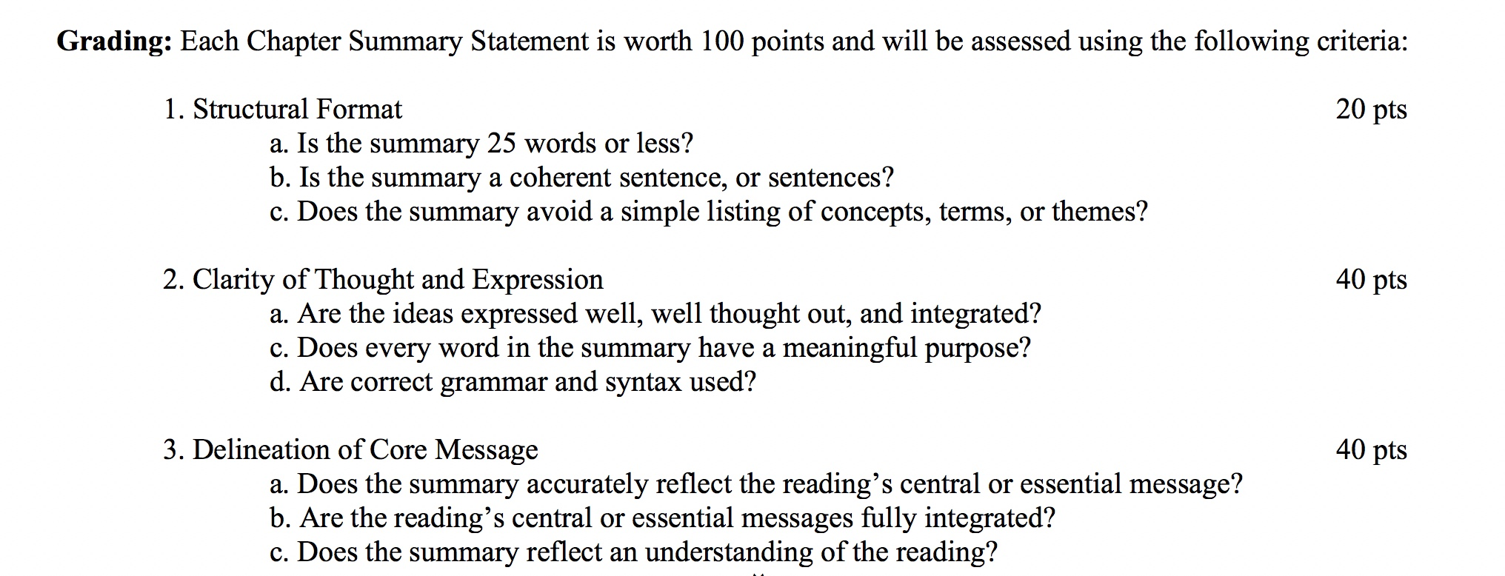
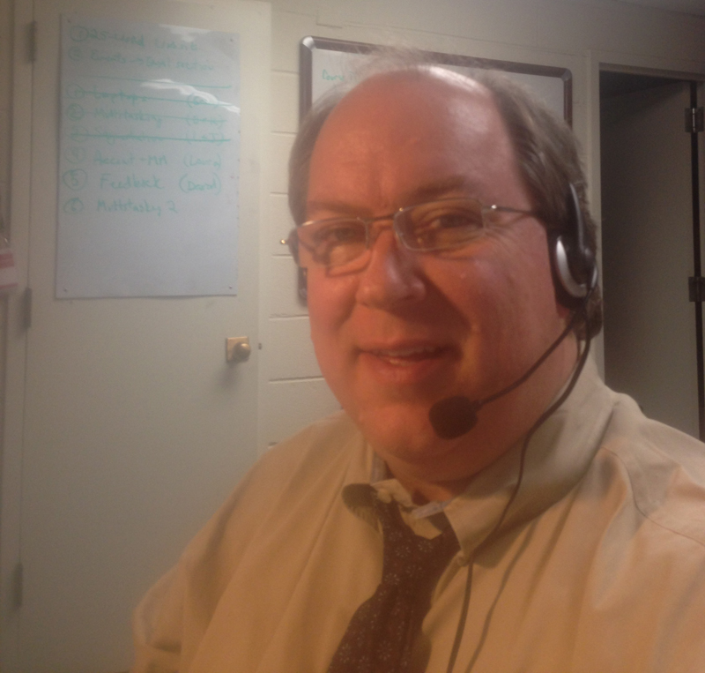
25-Word Summaries
plus Developmental Feedback
with Dragon Dictate

Slide 14
Oral Explanations
Learning Environment: Students create clear and coherently organized 10-15 minute videos that reflect the student’s understanding of the current topic under discussion, plus an application to their lives.
Learning Artifact Processing: Students analyze and interpret readings, notes, and discussions; organize concepts and ideas; apply to a life issue; create an oral explanation.
Learning Assessment: Video are assessed using a scoring guide focused on organization, clarity of thought and expression, essential content explanation and application.

Slide 15
Oral Explanation: Human Learning

Slide 16
Oral Explanations

Slide 17
Integrating Programs & Courses
alignment
clarity ☞

Slide 18
The Need for Clarity

Slide 19
alignment
Assessment
(as an add-on)
Goals &
Outcomes
Learning
Environment
C, B, S, & A
Processing
Student
Learning
Purpose
Need

Slide 20
Design Projects
Posters (Session)
Writing
Problem Solving
Case/Mini-Case Studies
Peer Review
Reading Responses
Video Creation
Reflections
25-Word Summaries
Oral Explanations
Problem Sets
Blog/Vlog Posts
Multiple-Choice Questions
MC Item Create/Evaluate
Design Critique
Presentation
Self-Created Artifact
Purpose
& Need
Goals &
Outcomes
Learning
Artifact
C, S, B, & A
Processing
Student
Learning
Learning
Assessment
Developmntl
Feedback
Performance
Feedback
direct
formative
summative
Learning
Artifact
Goals &
Outcomes
Learning
Environment
C, B, S, & A
Processing
Student
Learning
Course Embedded Assessment
Purpose
Need

Slide 21
Design Projects
Posters (Session)
Writing
Problem Solving
Case/Mini-Case Studies
Peer Review
Reading Responses
Video Creation
Reflections
25-Word Summaries
Oral Explanations
Problem Sets
Blog/Vlog Posts
Multiple Choice Questions
MC Item Create/Evaluate
Design Critique
Presentation
Self-Created Artifact
Learning
Assessment
Developmntl
Feedback
Performance
Feedback
direct
formative
summative
Learning
Artifact
C, B, S, & A
Processing
Goals &
Outcomes
Learning
Environment
Student
Learning
Course Embedded Assessment
Purpose
Need

Slide 22
Program Assessment (Education Major)
(Academic) Program Goals: Graduates have
1. Knowledge of educational concepts, student development, & teaching techniques; and,
2. Knowledge and skills sufficient to enter the K-12 education profession
(Student) Learning Outcomes: Students who complete the education major can
1. Describe fundamental educational concepts and purposes;
2. Explain student cognitive, social, linguistic, cultural, and physical development;
3. Create quality lessons, units, and sequences that align across ID components;
4. Implement strategies designed to foster learning across a diversity of students; and,
5. Demonstrate exceptional professional, legal, and ethical conduct.
Curriculum Map
Course | SLO1 | SLO2 | SLO3 | SLO4 | SLO5
ED1001
ED2010/Field
ED3305
ED3405
ED4501/Field
Course | SLO1 | SLO2 | SLO3 | SLO4 | SLO5
ED1001 | I |  | I | I
ED2010/Field | R |  | I | R
ED3305 | M&A | I | R
ED3405 |  | R | R | R
ED4501/Field |  |  | M&A | M&A
I = introduced; R = reinforced; M = mastered; A = assessed
Learning
Assessment
Developmntl
Feedback
Performance
Feedback
summative
direct
formative
summative
Learning
Artifact
C, B, S, & A
Processing
Goals &
Outcomes
Learning
Environment
Student
Learning
Course Embedded Assessment
Purpose
Need

Slide 23
Course to Program Translation
90-100 Exceeds 3
70-89 Meets 2
0-69 Below 1
Program Assessment (Education Major)
(Academic) Program Goals: Graduates have
1. Knowledge of educational concepts, student development, & teaching techniques; and,
2. Knowledge and skills sufficient to enter the K-12 education profession
Student Learning Outcomes: Students can
1. Describe fundamental educational concepts and purposes.
2. Explain student cognitive, social, linguistic, cultural, and physical development;
3. Create quality lessons, units, and sequences that align across ID components;
4. Implement strategies designed to foster learning across a diversity of students; and,
5. Demonstrate exceptional professional, legal, and ethical conduct.
3 pts
Curriculum Map
Learning
Assessment
Written
Comments
Performance
Assessment
Course | SLO1 | SLO2 | SLO3 | SLO4 | SLO5
1001 | I | I |  | I
2010/Field | R |  | I | R
3305 | M&A | I
3405 |  | R | R | R
4501/Field |  |  | M&A | M&A
100 pts
25-Word
Summary
C, B, S, & A
Processing
Learning
Assessment
Developmntl
Feedback
Performance
Feedback
summative
direct
formative
summative
Learning
Artifact
C, B, S, & A
Processing
Goals &
Outcomes
Learning
Environment
Student
Learning
Course Embedded Assessment
Purpose
Need

Slide 24
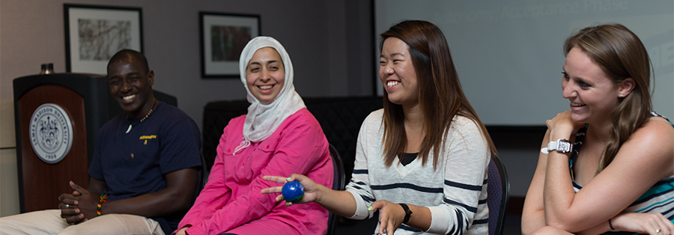
Integrating Gen Ed & Courses
alignment
moving parts ☞

Slide 25
Managing Moving Parts

Slide 26
General Education Goals & Outcomes (@ VT)
Discourse
Comp/Quant
Thinking
Reasoning
Soc Sci
Reasoning
Nat Sci
Practice in
Design/Arts
Identity &
Equity in US
Et harum rerum
Nam libero nobii
Quo minus ideo
Autem lev aut et
Voluptates est
Sed ut natus
Sit laudantium
Totam rem ipsa
Quae ab illo et
Quasi beatae su
Ipsam quia odit
Dolere magnam
Ut enim ad quis
Nostrum ullam
Suscipit nisi ut
Et harum rerum
Nam libero nobii
Quo minus ideo
Autem et aut et
Sed ut natus
Sit laudantium
Totam rem ipsa
Quae ab illo et
Quasi beatae su
Quaerat aliqua
Dolere magnam
Ut enim ad quis
Nostrum ullam
Suscipit nisi ut
Velit esse quam
Reasoning in the Social Sciences
Identify fundamental concepts of the social sciences.
Analyze human behavior, social institutions, and/or patterns of culture using theories and methods of social science.
Identify interconnections among and differences between social institutions, groups, and individuals.
Analyze the ways in which values and beliefs relate to human behavior and social relationships.

Slide 27
Reasoning in the Social Sciences
Identify fundamental concepts of the social sciences.
Analyze human behavior, social institutions, and/or patters of culture using theories and methods of social science.
Identify interconnections among and differences between social institutions, groups, and individuals.
Analyze the ways in which values and beliefs relate to human behavior and social relationships.
Curriculum Map
Course | SLO1 | SLO2 | SLO3 | SLO4
 | SLO1 | SLO2 | SLO3 | SLO4
PSY202 | ✓ | ✓ | ✓
PHL301 | ✓ |  | ✓ | ✓
SOC311 |  | ✓ | ✓ | ✓
EDU292 | ✓ | ✓ | ✓
 | SLO1 | SLO2 | SLO3 | SLO4
PSY202 | I, R, M, & A | I, R, M, & A | I, R, M, & A
PHL301 | I, R, M, & A |  | I, R, M, & A | I, R, M, & A
SOC311 |  | I, R, M, & A | I, R, M, & A | I, R, M, & A
EDU292 | I, R, M, & A | I, R, M, & A | I, R, M, & A
 | SLO1 | SLO2 | SLO3 | SLO4
PSY202
PHL301
SOC311
EDU292
SLO 1
 | Pedagogy | Assessment | Scoring | Translation
PSY202 | Lecture | Presentation | 100 pts
PHL301 | Readings | Paper | 50 pts
SOC311
EDU292 | Online Module | ePortfolio | 100 pts

Slide 28
SLO 1
 | Pedagogy | Assessment | Scoring | Translation
PSY202 | Lecture | Presentation | 100 pts | 90 -100 pts = 3 60 - 89 pts = 2 0 - 59 pts = 1
PHL301 | Reading | Paper | 50 pts | 45 - 50 pts = 3 35 - 44 pts = 2 0 - 34 pts = 1
SOC311
EDU292 | Online Module | ePortfolio | 100 pts | 80 -100 pts = 3 60 - 79 pts = 2 0 - 59 pts = 1

Slide 29
Reasoning in the Social Sciences
Identify fundamental concepts of the social sciences.
Analyze human behavior, social institutions, and/or patterns of culture using theories and methods of social science.
Identify interconnections among and differences between social institutions, groups, and individuals.
Analyze the ways in which values and beliefs relate to human behavior and social relationships.
Curriculum Map
 | SLO1 | SLO2 | SLO3 | SLO4
PSY202 | ✓ | ✓ | ✓
PHL301 | ✓ |  | ✓ | ✓
SOC311 |  | ✓ | ✓ | ✓
EDU292 | ✓ | ✓ | ✓
 | SLO1 | SLO2 | SLO3 | SLO4
PSY202 | ✓ | ✓ | ✓
PHL301 | ✓ |  | ✓ | ✓
SOC311 |  | ✓ | ✓ | ✓
EDU292 | ✓ | ✓ | ✓
 | SLO1 | SLO2 | SLO3 | SLO4
PSY202 | ✓ | ✓ | ✓
PHL301 | ✓ |  | ✓ | ✓
SOC311 |  | ✓ | ✓ | ✓
EDU292 | ✓ | ✓ | ✓
 | SLO1 | SLO2 | SLO3 | SLO4
PSY202 | ✓ | ✓ | ✓
PHL301 | ✓ |  | ✓ | ✓
SOC311 |  | ✓ | ✓ | ✓
EDU292 | ✓ | ✓ | ✓
Translations should be determined by faculty, or faculty teams, and should involve norming of assessments across faculty and departments to increase scoring consistency (reliability).
While the particulars may be different across departments, the categories may be the same: theories, theorists, methodologies, analyses, core knowledge, and common terms.

Slide 30
Epiloge

Slide 31
Top Down and Bottom Up
Fully Integrating Learning and Assessment Practices
www.ResearchNotRhetoric.com/rnr-talks.php
Peter E. Doolittle
Director, School of Education
Professor, Educational Psychology
Virginia Tech • Blacksburg • Virginia
Institute on General Education and Assessment
Notes:
Peter

