Slide 1
Integrating Learning, Memory, & Experience Fostering Deep and Flexible Learning
2019 Teaching and Learning Summit
Wiley Publishing
Peter E. Doolittle
Director, School of Education
Professor, Educational Psychology
Virginia Tech • Blacksburg • Virginia

Slide 2
Clarity

Slide 3
Learning and Memory
Words →

Slide 4
Rest
Tired
Awake
Dream
Snore
Bed
Eat
Slumber
Sound
Comfort
Wake
Night
Rest
Tired
Awake
Dream
Snore
Bed
Eat
Slumber
Sound
Comfort
Wake
Night
That’s all!

Slide 5
Activity Debrief
Meaning is constructed during experience.
Construction results from processing.
Knowledge is organized.
When specifics are lost, meaning remains.
Strategies are used to function more effectively.
We can assess the effectiveness of our thinking.

Slide 6
Cognitively
(thinking)
Behaviorally
(doing)
Processing
Engagement
Active Learning
Hands On, Minds On
What we process
we learn.
Affectively
(being)
Socially
(interacting)

Slide 7
6 Principles of Deep and Flexible Learning
Learning through practice at retrieval
Learning through varied tasks and purposes
Learning at the principle level
Learning awareness and control (metacognition)
Learning in response to developmental feedback
Learning embedded in prior knowledge and experience
(Engle, 2006; Halpern & Hakel, 2003; Mariano, Doolittle, & Hicks, 2009; Wagner, 2006)
Notes:
Metacognition: plan, monitor, evaluation, & remediate (comprehension monitoring & remediation)

Slide 8
Learning and Memory
What we process
we learn
Cognitive
Processing
Behavioral
Processing
Social
Processing
Affective
Processing
Practice at Retrieval
Vary Tasks
and Purposes
Principle
Level
Awareness
and Control
Developmental
Feedback
Prior Knowledge
& Experience

Slide 9
Processing

Slide 10
Instructional Strategies I

Slide 11
25-Word Summaries
Learning Environment: Students create clear and coherently organized 25-word summaries that reflects the essential meaning of the current reading, lecture, video, movie, activity, or experience.
Learning Artifact: Students analyze and interpret a reading, lecture, video, movie, activity, or experience in order to extract the essential meaning and compose a 25-word summary.

Slide 12
25-Word Summaries
A Sample (after reading an article):
Through developing, implementing, and assessing model-eliciting activities, engineering faculty members’ beliefs and decisions about teaching, learning, and assessment shift from teacher-centered toward student-centered.
[23 Words]

Slide 13
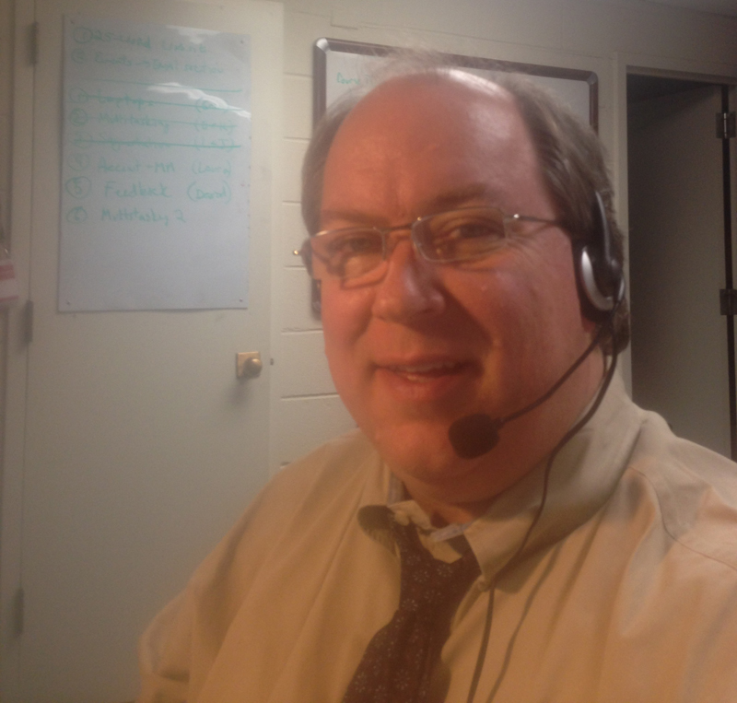
25-Word Summaries
Plus Developmental Feedback
with Dragon Dictate

Slide 14
25-Word Summaries
✓
Learning through practice at retrieval
Learning through varied tasks and purposes
Learning at the principle level
Learning awareness and control (metacognition)
Learning in response to developmental feedback
Learning embedded in prior knowledge and experience
✓
✓
✓
✓
✓

Slide 15
Instructional Design w/Embedded Assessment

Slide 16
Instructional Design w/Embedded Assessment
Assessment
(as an add-on)
learning alignment
Goals &
Outcomes
Learning
Environment
C, B, S, & A
Processing
Student
Learning
Purpose
Need

Slide 17
Design Projects
Posters (Session)
Writing
Problem Solving
Case/Mini-Case Studies
Peer Review
Reading Responses
Video Creation
Reflections
25-Word Summaries
Design Critique
Problem Sets
Blog/Vlog Posts
Multiple-Choice Questions
MC Item Create/Evaluate
Oral Explanations
Presentation
Self-Created Artifact
Learning
Assessment
Developmntl
Feedback
Performance
Feedback
direct
formative
summative
Learning
Artifact
Goals &
Outcomes
Learning
Environment
C, B, S, & A
Processing
Student
Learning
Course Embedded Assessment
Purpose
Need

Slide 18
Use Instructional Strategies to Herd Your Cats

Slide 19
Instructional Strategies II

Slide 20
Oral Explanations
Learning Environment: Students create clear and coherently organized 10-15 minute videos that reflect the student’s understanding of the current topic under discussion, plus an application to their lives.
Learning Artifact: Students analyze and interpret readings, notes, and discussions; organize concepts and ideas; apply to a life issue; create an oral explanation.

Slide 21
Oral Explanation

Slide 22
Oral Explanation

Slide 23
Oral Explanation
✓
Learning through practice at retrieval
Learning through varied tasks and purposes
Learning at the principle level
Learning awareness and control (metacognition)
Learning in response to developmental feedback
Learning embedded in prior knowledge and experience
✓
✓
✓
✓
✓

Slide 24
The 7 C’s of (Internal) Motivation

Slide 25
The 7 C’s of (Internal) Motivation
Choice
Caring (interest/value)
Control
Challenge
Collaboration
Competence
Curiosity
Increased
Learning
Increased
Processing
Increased
Motivation
Learning
Environment

Slide 26
What we process
we learn
Cognitive
Processing
Behavioral
Processing
Social
Processing
Affective
Processing
Practice at Retrieval
Vary Tasks
and Purposes
Principle
Level
Awareness
and Control
Developmental
Feedback
Prior Knowledge
& Experience
Purpose
And Need
Goals and
Outcomes
Learning
Artifacts
C, B, S, & A
Processing
Developmental
Feedback
Student
Learning
Choice
Caring
Control
Challenge
Collaboration
Competence
Curiosity

Slide 27
Integrating Learning, Memory, & Experience Fostering Deep and Flexible Learning
2019 Teaching and Learning Summit
Wiley Publishing
Peter E. Doolittle
Director, School of Education
Professor, Educational Psychology
Virginia Tech • Blacksburg • Virginia

