Slide 1
Teaching for Deep and Flexible Learning
Fundación Educacional Seminarium peterdoolittle.org
Neuroscience, Cognition, and Technology Seminar
Peter E. Doolittle
Director, School of Education
Professor, Educational Psychology
Virginia Tech • Blacksburg • Virginia
Twitter: @pdoopdoo
Linked In: peter-doolittle
Web: peterdoolittle.org

Slide 2
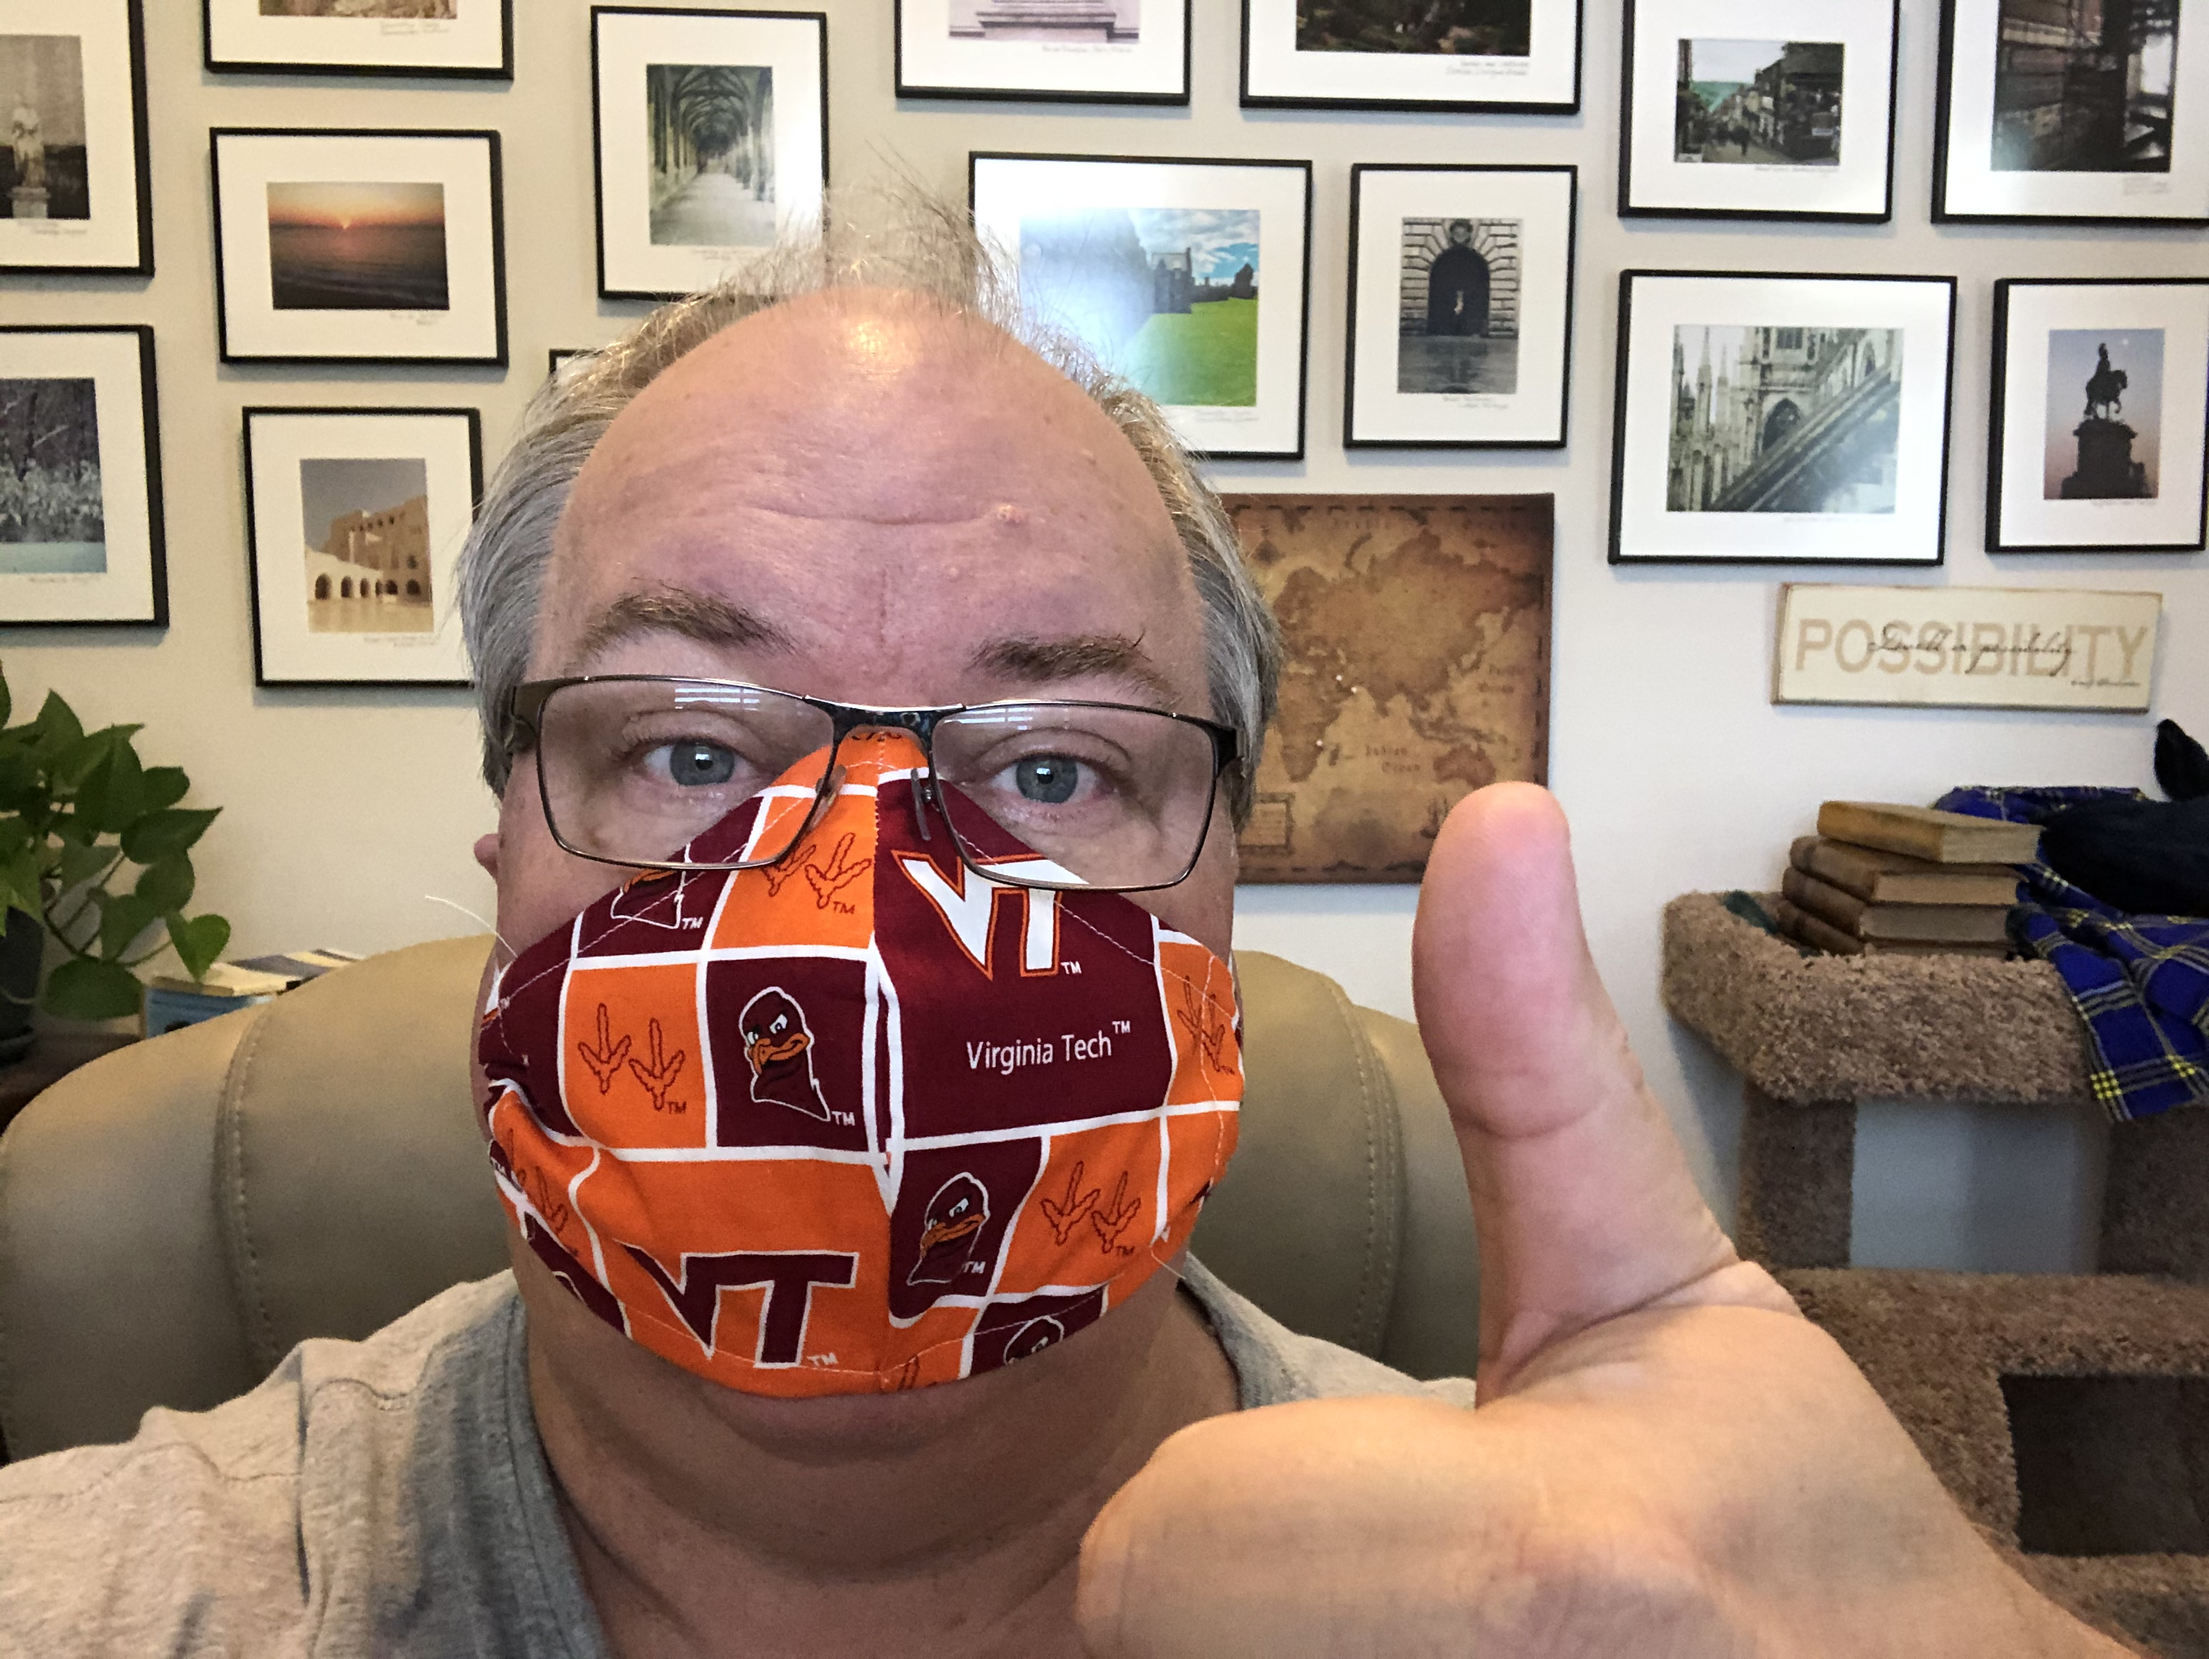
Peter Doolittle
Educational Psychologist, Virginia Tech
Teaching, Learning, and Technology
Middle and High School CS and Math

Slide 3
Agenda
Learning
Principles
Applications

Slide 4
Learning

Slide 5
Rest
Tired
Awake
Dream
Snore
Bed
That’s all!
Eat
Pillow
Sound
Comfort
Stars
Night

Slide 6
Learning
What was the central theme?
Sleep

Slide 7
Learning
How many words do you recall?

Slide 8
Rest
Tired
Awake
Dream
Snore
Bed
Eat
Pillow
Sound
Comfort
Stars
Night

Slide 9
Learning Principles
and the Brain

Slide 10
Learning Principles
and the Brain
Learning occurs through experience
Experience creates functional neural pathways
Pathways are created and activated through attention
Attention is intentional and incidental
Experience → Attention → Pathways is a feedback loop
Individual brains differ based on experience

Slide 11
Learning Principles
and the Brain
Processing

Slide 12
Cognitively
(thinking)
Behaviorally
(doing)
Processing
Engagement
Active Learning
Hands On Learning
What we process
we learn.
Affectively
(being)
Socially
(interacting)

Slide 13
Shallow Learning
What we process
we learn.
Deep Learning

Slide 14
Shallow Learning

Slide 15
Deep Learning

Slide 16
Shallow vs Deep Learning
Shallow Learning
Deep Learning
Abstract
Independent
Rigid
Specific Application
Integrated
Relational
Flexible
Generalizable

Slide 17
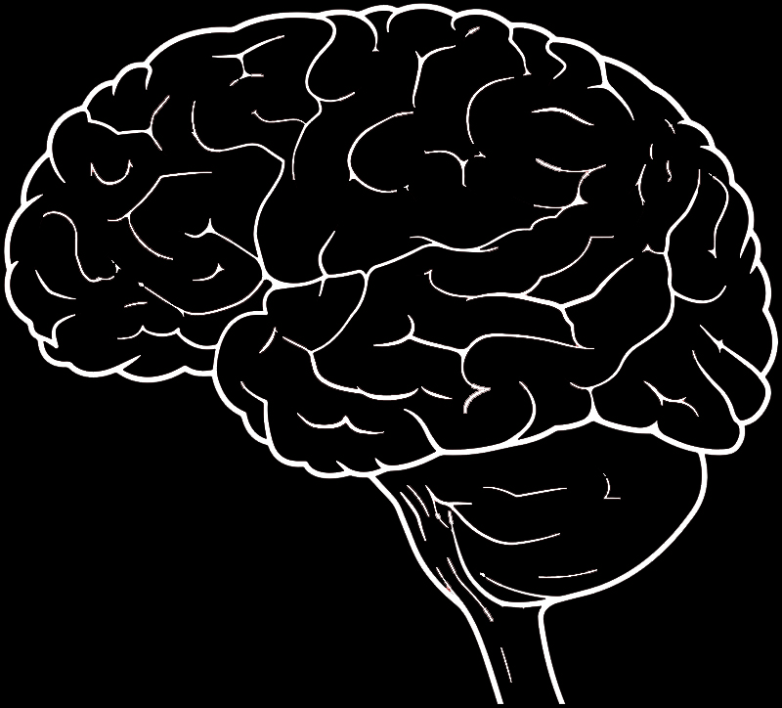
Learning Principles
and the Brain
Learning occurs through experience
Experience creates functional neural pathways
Pathways are created and activated through attention
Attention is intentional and incidental
Experience → Attention → Pathways is a feedback loop
Individual brains differ based on experience

Slide 18
Learning Principles
and the Brain
Principle
1. Learning through experience
2. Experience creates pathways
Application
1. Learning through practice at retrieval
2. Learning through varied tasks and purposes

Slide 19
Learning Principles
and the Brain
Principle
3. Pathways are created through attention
4. Attention is intentional and incidental
Application
3. Learning by focusing on the principle ideas
4. Learning by awareness and control (metacognition)

Slide 20
Learning Principles
and the Brain
Principle
5. Experience-attention-pathways feedback loop
6. Individual brains differ based on experience
Application
5. Learning in response to developmental feedback
6. Learning embedded in prior knowledge and experience

Slide 21
Learning Principles
and the Brain
Learning through practice at retrieval
Learning through varied tasks and purposes
Learning by focusing on the principle ideas
Learning awareness and control (metacognition)
Learning in response to developmental feedback
Learning embedded in prior knowledge and experience

Slide 22
Instructional Strategies

Slide 23
Summarizing
What is a summary? long text → short text
main ideas, essence, gist
1. identify important ideas
2. discard unimportant ideas
3. integrate main ideas
4. construct summary sentence
(Bean & Steenwyk, 1984; Britt & Sommer, 2004; Jitendra et al., 2000; Westby et al., 2010)

Slide 24
Summarizing
Summarizing is learned: ↑ time
↑ practice
↑ processing
Impact of summarizing: ↑ comprehension
↑ retention
↑ application
(Bean & Steenwyk, 1984; Britt & Sommer, 2004; Jitendra et al., 2000; Westby et al., 2010)

Slide 25
Summarizing
Summarizing is learned:
↑ time
↑ practice
↑ processing
→
Impact of summarizing:
↑ comprehension
↑ retention
↑ application
(Bean & Steenwyk, 1984; Britt & Sommer, 2004; Jitendra et al., 2000; Westby et al., 2010)

Slide 26
Summarizing
Grading summarizing: length
content
expression
Improving summarizing: feedback on
length
content
expression
(Bean & Steenwyk, 1984; Britt & Sommer, 2004; Jitendra et al., 2000; Westby et al., 2010)

Slide 27
Summarizing
✓
Learning through practice at retrieval
Learning through varied tasks and purposes
Learning at the principle level
Learning awareness and control (metacognition)
Learning in response to developmental feedback
Learning embedded in prior knowledge and experience
✓
✓
✓
✓
✓

Slide 28
Questions?

Slide 29
Teaching for Deep and Flexible Learning
Fundación Educacional Seminarium peterdoolittle.org
Neuroscience, Cognition, and Technology Seminar
Peter E. Doolittle
Director, School of Education
Professor, Educational Psychology
Virginia Tech • Blacksburg • Virginia
Twitter: @pdoopdoo
Linked In: peter-doolittle
Web: peterdoolittle.org

