Slide 1
Working Memory and the Integration of Technology in Teaching & Learning
Fundación Educacional Seminarium peterdoolittle.org
Neuroscience and Education Seminar
Peter E. Doolittle
Director, School of Education
Professor, Educational Psychology
Virginia Tech • Blacksburg • Virginia
Twitter: @pdoopdoo
Linked In: peter-doolittle
Web: peterdoolittle.org

Slide 2
Agenda
Learning
Principles
Applications

Slide 3
Review

Slide 4
Learning Principles
and the Brain
Learning occurs through experience
Experience creates functional neural pathways
Pathways are created and activated through attention
Attention is intentional and incidental
Experience → Attention → Pathways is a feedback loop
Individual brains differ based on experience

Slide 5
Cognitively
(thinking)
Behaviorally
(doing)
What we process
we learn.
Affectively
(being)
Socially
(interacting)

Slide 6
Learning Principles
for Teaching and Learning
Learning through practice at retrieval
Learning through varied tasks and purposes
Learning by focusing on the principle ideas
Learning awareness and control (metacognition)
Learning in response to developmental feedback
Learning embedded in prior knowledge and experience

Slide 7
Learning &
Working Memory

Slide 8
Learning &
Working Memory
Engaging in Current Thought
Store Immediate Experiences
Access Long-Term Memory, as needed
Process Experiences and Memory
Maintaining Current Goals for Processing
Attentional
Control

Slide 9
Learning &
Working Memory Capacity
STM = Storage
WMC = Storage +
Processing
Short Term Memory
1 2 3 4 5 6 7 8 9 10 11 12

Slide 10
Learning &
Working Memory Capacity
Write the words in the chat, in order.
Activity Directions
(3 + 7) / 2 = 5 ? Cow
(8 - 3) + 1 = 7 ? Star
Cow, Star

Slide 11
Learning &
Working Memory Capacity
Write the words in the chat, in order.
(9 - 6) / 3 = 2 ? Grass
(5 + 3) - 6 = 2 ? Phone
Grass, Phone

Slide 12
Learning &
Working Memory Capacity
Write the words in the chat, in order.
(7 + 2) + 1 = 9 ? White
(6 / 2) + 4 = 8 ? Cement
(2 - 0) / 2 = 2 ? Pony
White, Cement, Pony

Slide 13
Learning &
Working Memory Capacity
Write the words in the chat, in order.
(3 + 2) - 4 = 2 ? Book
(6 + 2) / 4 = 2 ? Printer
(8 - 3) * 2 = 10 ? Speaker
(4 / 2) - 4 = 4 ? Duck
Book, Printer, Speaker, Duck

Slide 14
Learning &
Working Memory Capacity
How did you do? ☺
In the chat, please type in the highest number of words (2, 3, or 4) that you were able to remember correctly and in order.

Slide 15
Learning
Working Memory Capacity
Working Memory Cap
Short Term Memory
Storage
Processing
Storage
Limited Capacity
Limited Duration
Limited Focus
1 2 3 4 5 6 7 8 9 10 11 12

Slide 16
Learning &
Working Memory Capacity
Positive Impacts of ↑ WMC:
Complex Cognition
Reading Ability
Mathematical Ability
Fluid Intelligence
Technology Rich Environments
Working Memory
Short Term Memory
Attentional
Control
Storage
Processing
Storage
1 2 3 4 5 6 7 8 9 10 11 12

Slide 17
Learning &
Working Memory Capacity
Where should teachers focus?
↑ Increasing WMC
or
Using Strategies
Working Memory
Short Term Memory
Storage
Processing
Storage
1 2 3 4 5 6 7 8 9 10 11 12

Slide 18
Learning &
Working Memory Capacity
WMC Strategies
Segmenting Instruction
Scaffolding Instruction
Lower Cognitive Load
Review Often
Practice with Feedback
Reduce Distractions
Working Memory
Short Term Memory
Storage
Processing
Storage
1 2 3 4 5 6 7 8 9 10 11 12

Slide 19
Learning &
Working Memory Capacity
WMC Strategies
Segmenting Instruction
Scaffolding Instruction
Lower Cognitive Load
Review Often
Practice with Feedback
Reduce Distractions
Learning Principles
Practice at Retrieval
Vary Tasks and Purposes
Focus on Principle Ideas
Foster Awareness and Control
Use Developmental Feedback
Embed in Prior Knowledge

Slide 20
Instructional Strategies with Technology

Slide 21
Instructional Strategies with Technology
Technology is neither good nor bad
but using it makes it so.

Slide 22
Instructional Strategies with Technology
Learning through practice at retrieval
Learning through varied tasks and purposes
Learning by focusing on the principle ideas
Learning awareness and control (metacognition)
Learning in response to developmental feedback
Learning embedded in prior knowledge and experience

Slide 23
Start with Your LMS
What can your LMS do?
Chats
Video
Quizzes
Surveys/Polling
Collaboration Tools

Slide 24
Practice at Retrieval
Varied Tasks & Purposes
How to use technology to:
Motivate students to retrieve knowledge and skills to solve problems, answer questions, or create artifacts.
Provide explanations
Create a representation
Demonstrate problem solving
Brainstorm solutions

Slide 25
FlipGrid
flipgrid.com

Slide 26
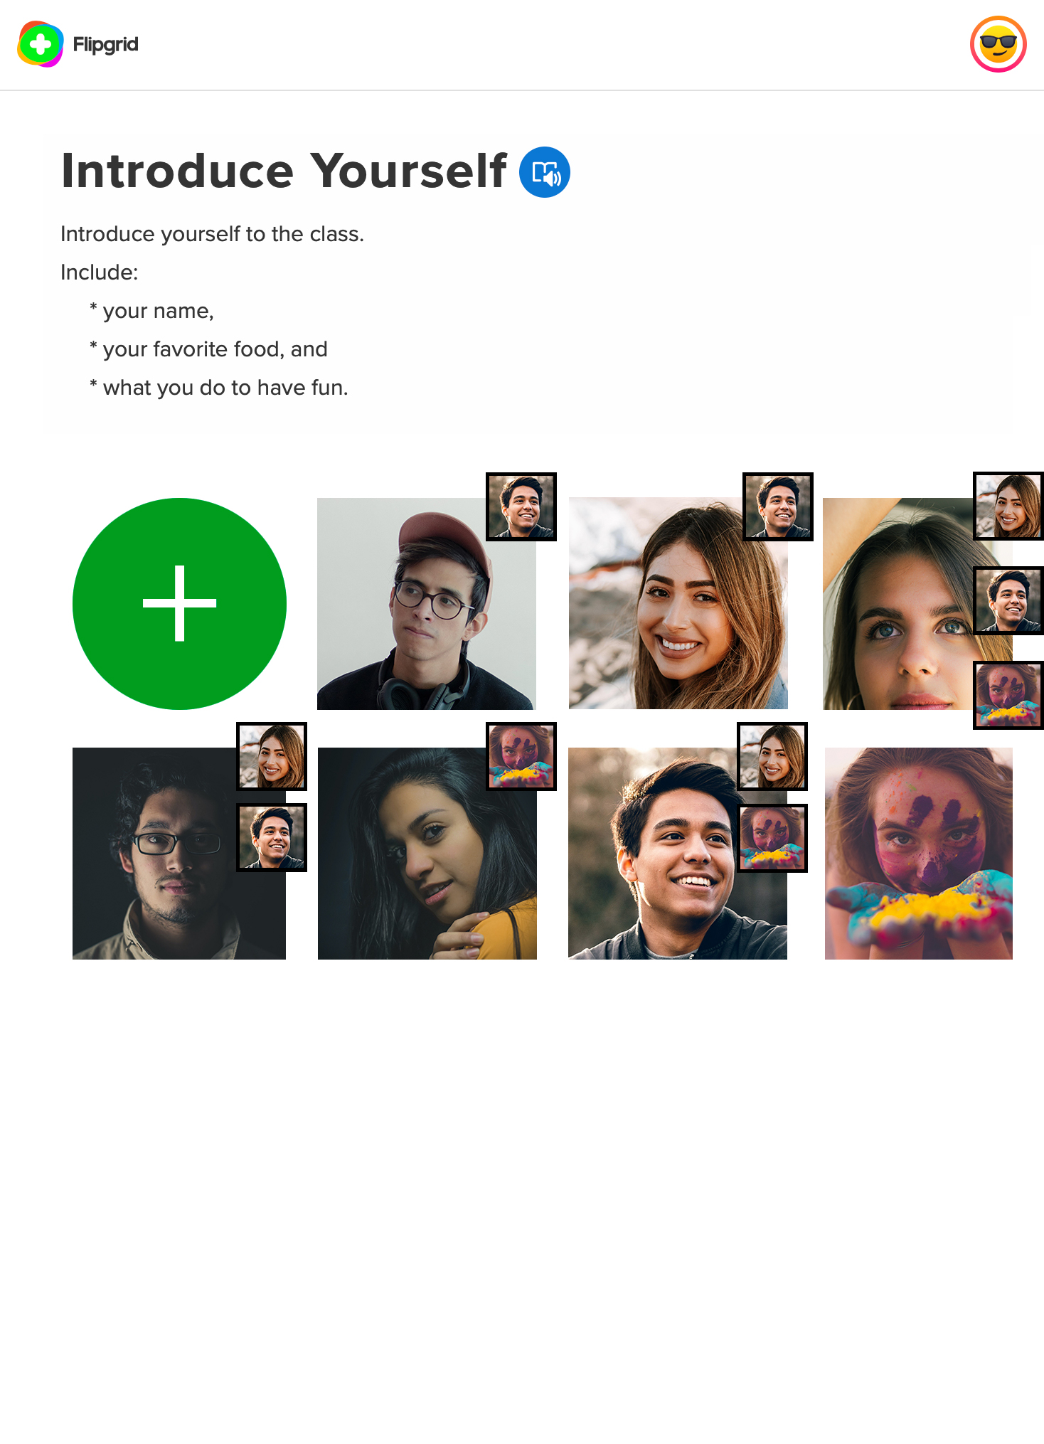
FlipGrid
Flipgrid: Video-based Discussions
Create
Privacy
Access
Record

Slide 27
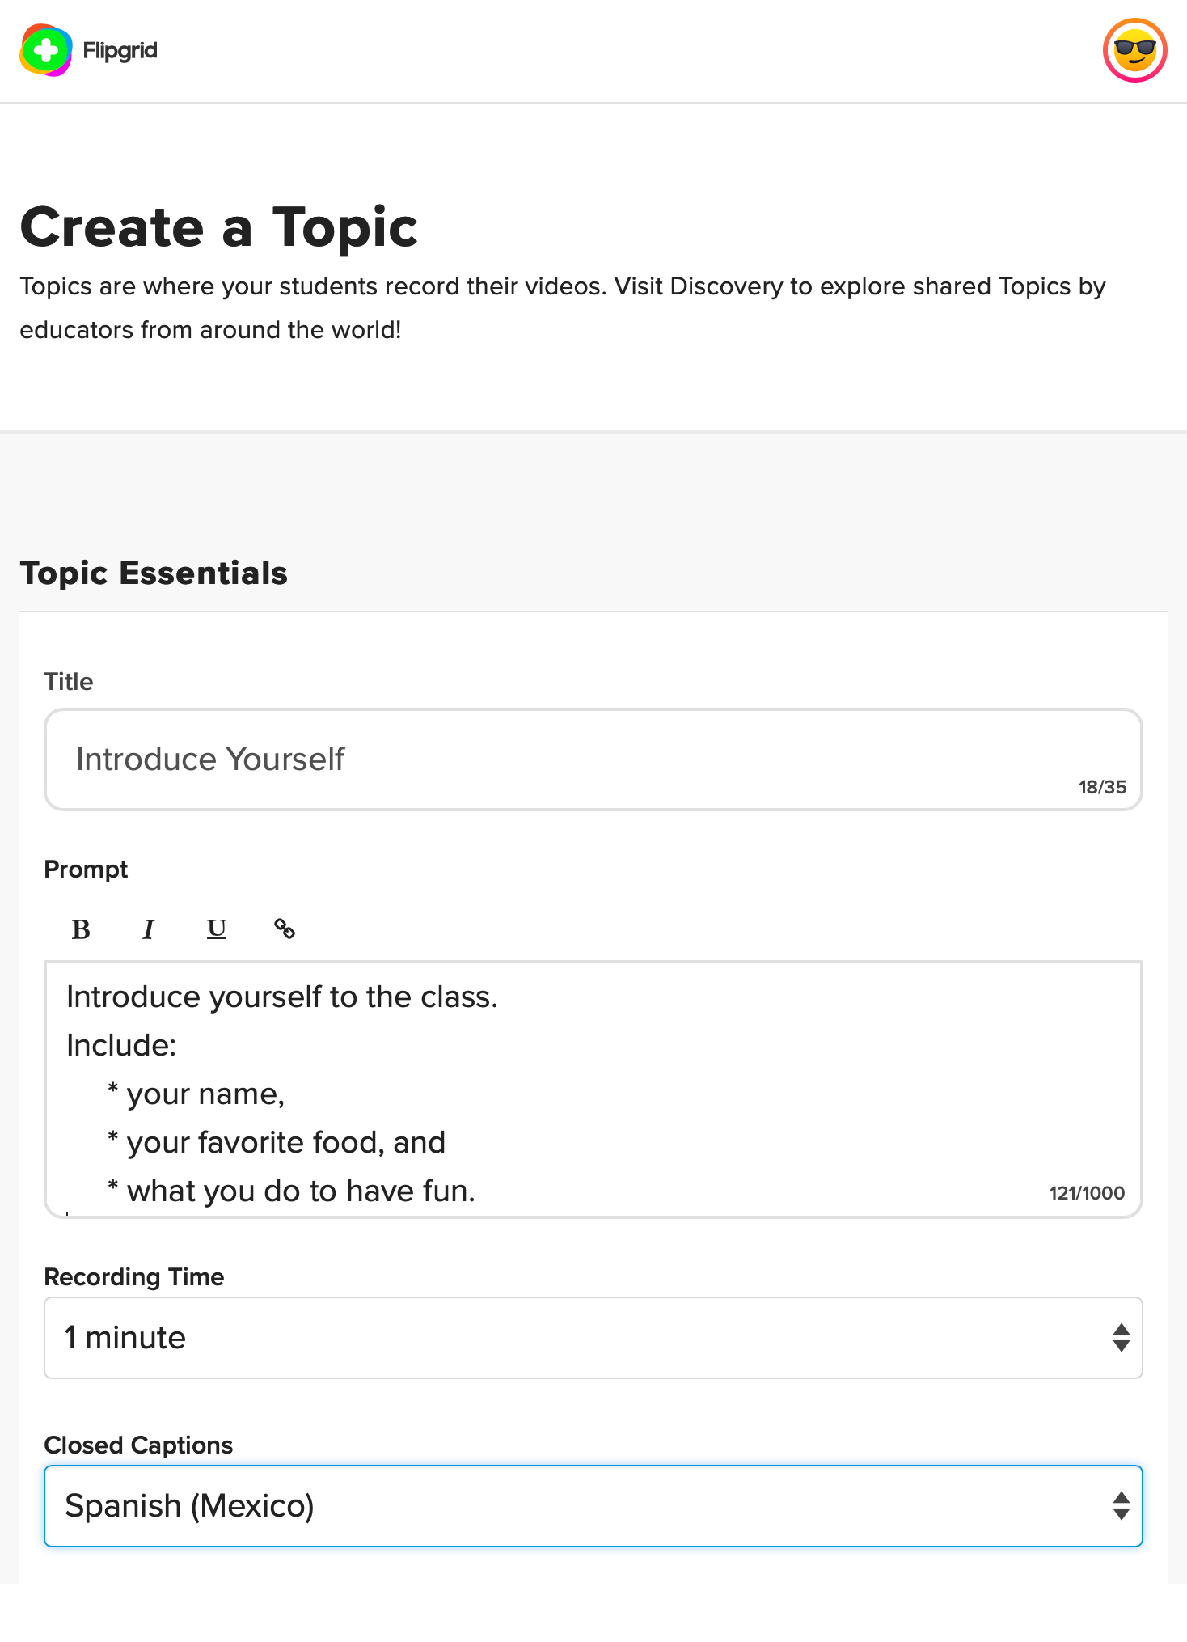
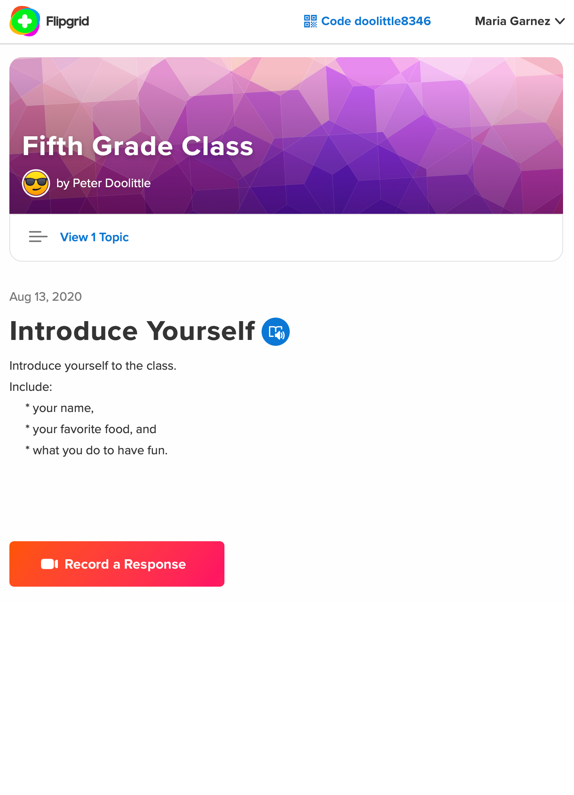

Slide 28
FlipGrid
flipgrid.com

Slide 29
Instructional Strategies with Technology
Technology is neither good nor bad
but using it makes it so.

Slide 30
Questions?

Slide 31
Working Memory and the Integration of Technology in Teaching & Learning
Fundación Educacional Seminarium peterdoolittle.org
Neuroscience and Education Seminar
Peter E. Doolittle
Director, School of Education
Professor, Educational Psychology
Virginia Tech • Blacksburg • Virginia
Twitter: @pdoopdoo
Linked In: peter-doolittle
Web: peterdoolittle.org

