Slide 1
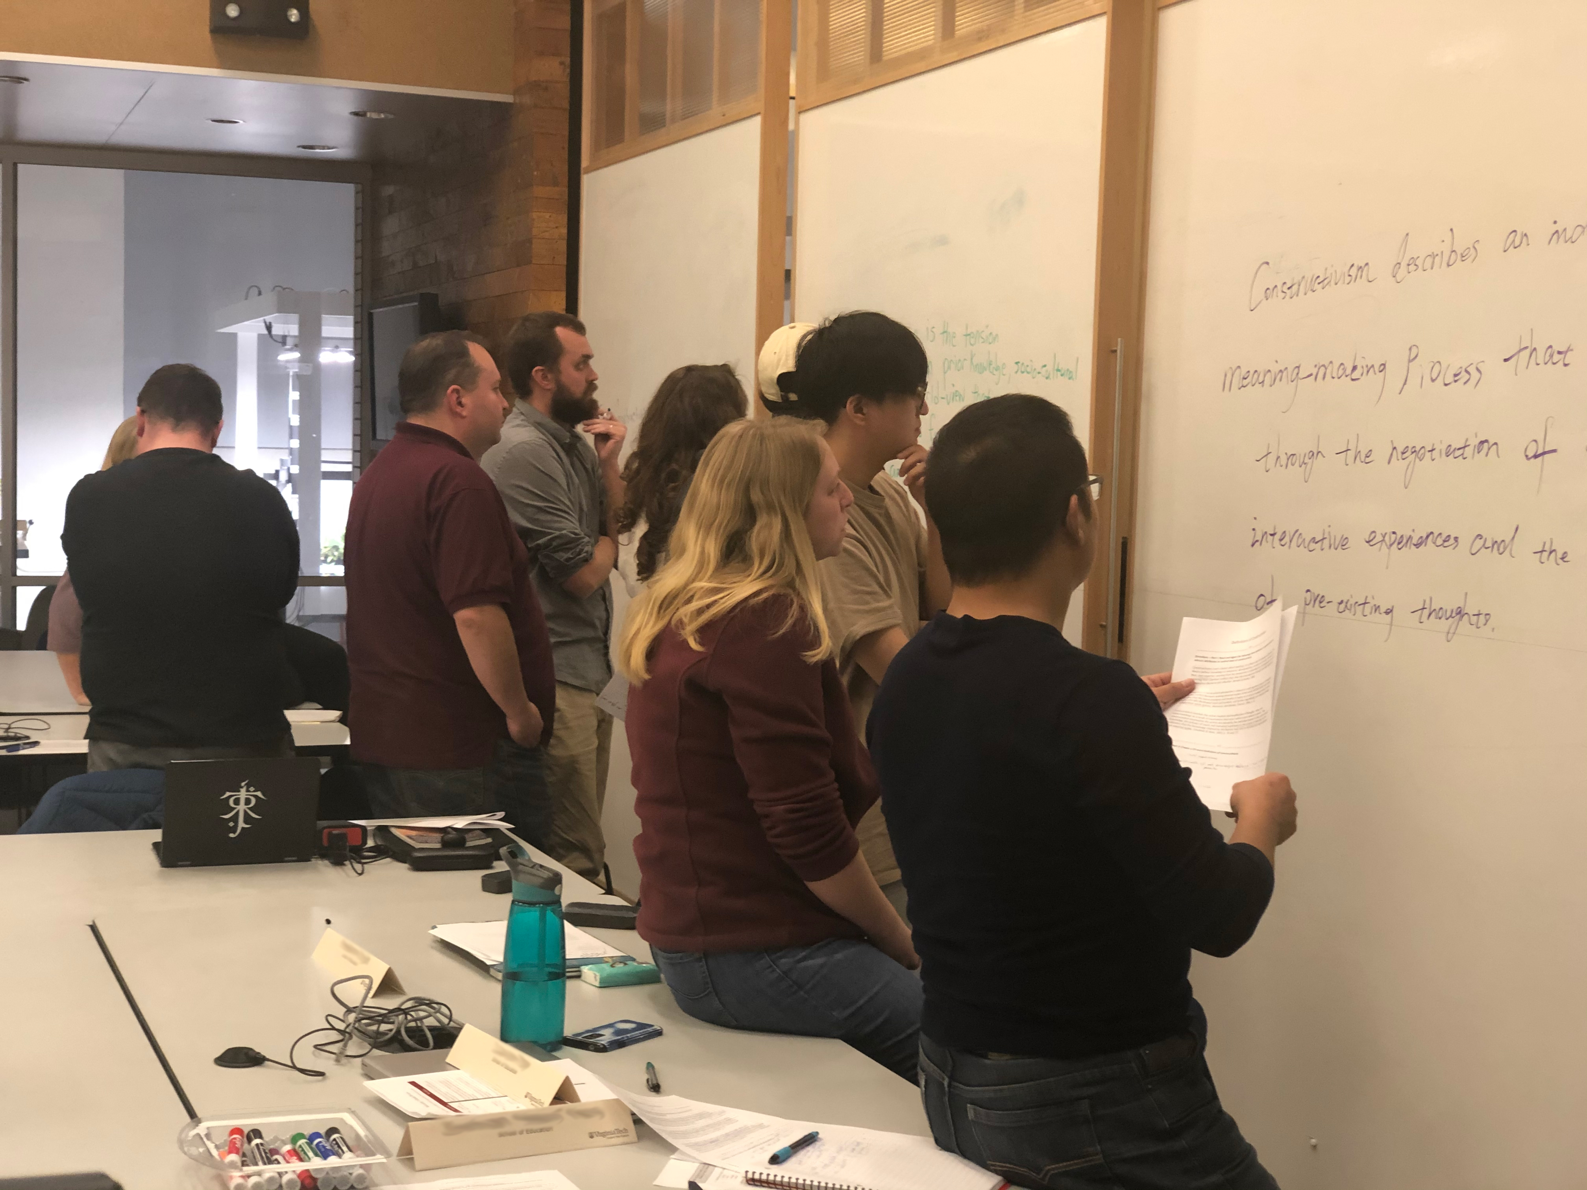
Reassessing Reimagining Recalibrating
Teaching
Learning
&
Peter E. Doolittle
Professor, Educational Psychology
Virginia Tech
pdoo@vt.edu
@pdoodoo
peter-doolittle

Slide 2
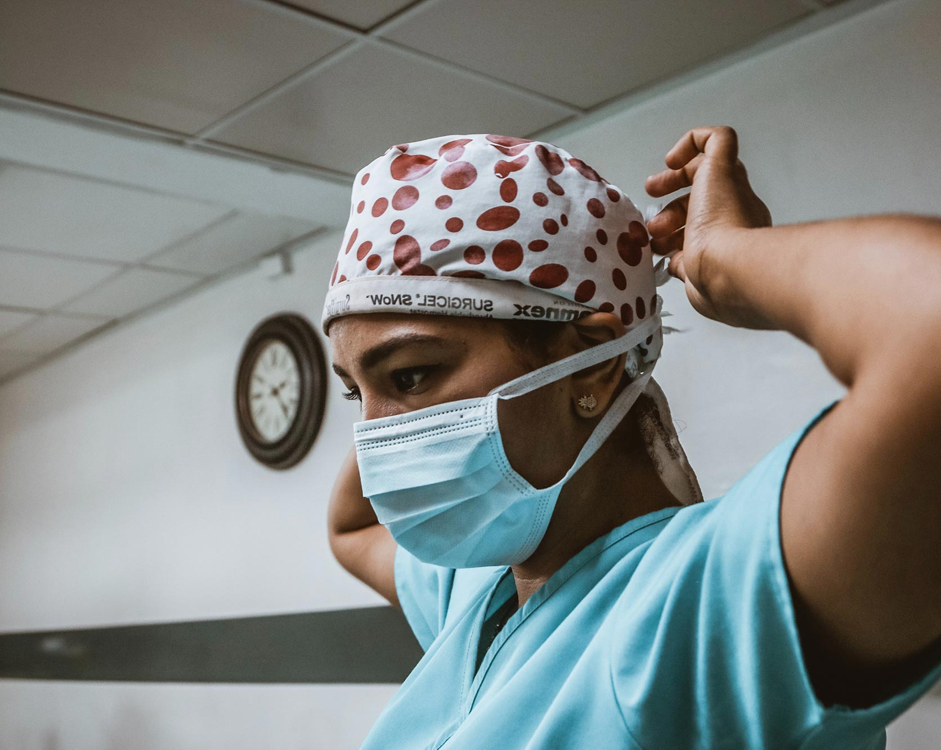
Agenda
Where are we?
What’s ahead?
Who knows?
Presentation Files

Slide 3
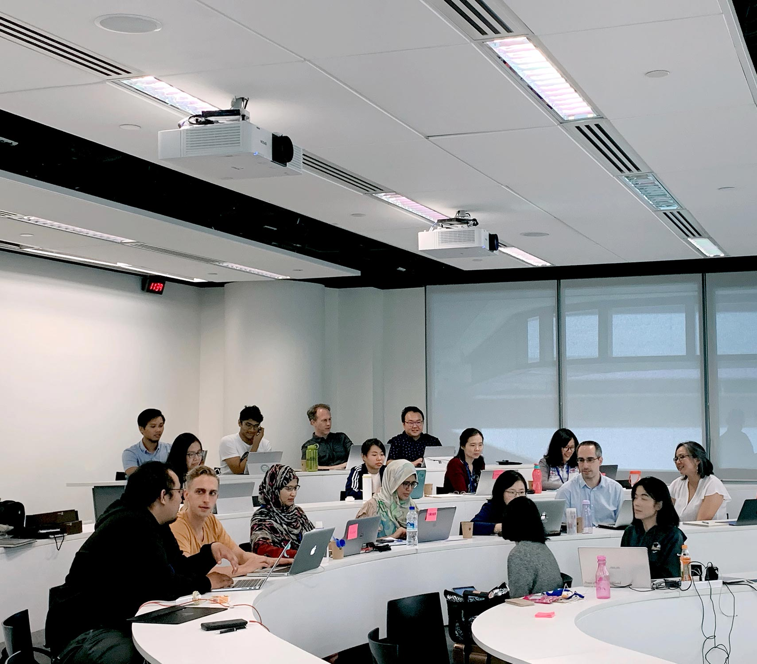
Post-COVID Pedagogy

Slide 4
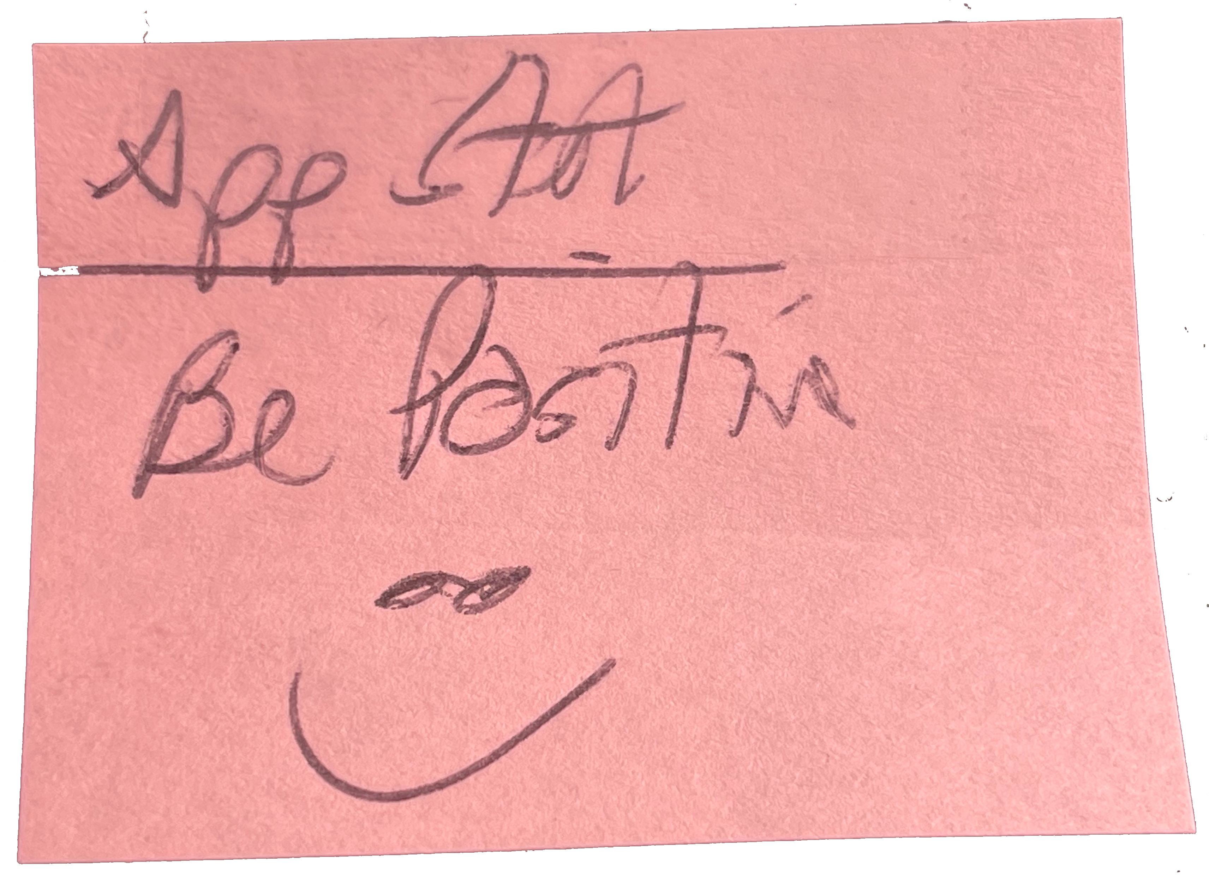

Slide 5
Uncertainty

Slide 6
Where Are We Now?
COVID Infection, Mental Health, & Food Insecurities
Overall, 7% of students indicated a COVID infection
COVID infection was associated with
food insecurities
anxiety
depression
( The Hope Center, 2021; 100,000 students, Fall 2020, Self-report )

Slide 7
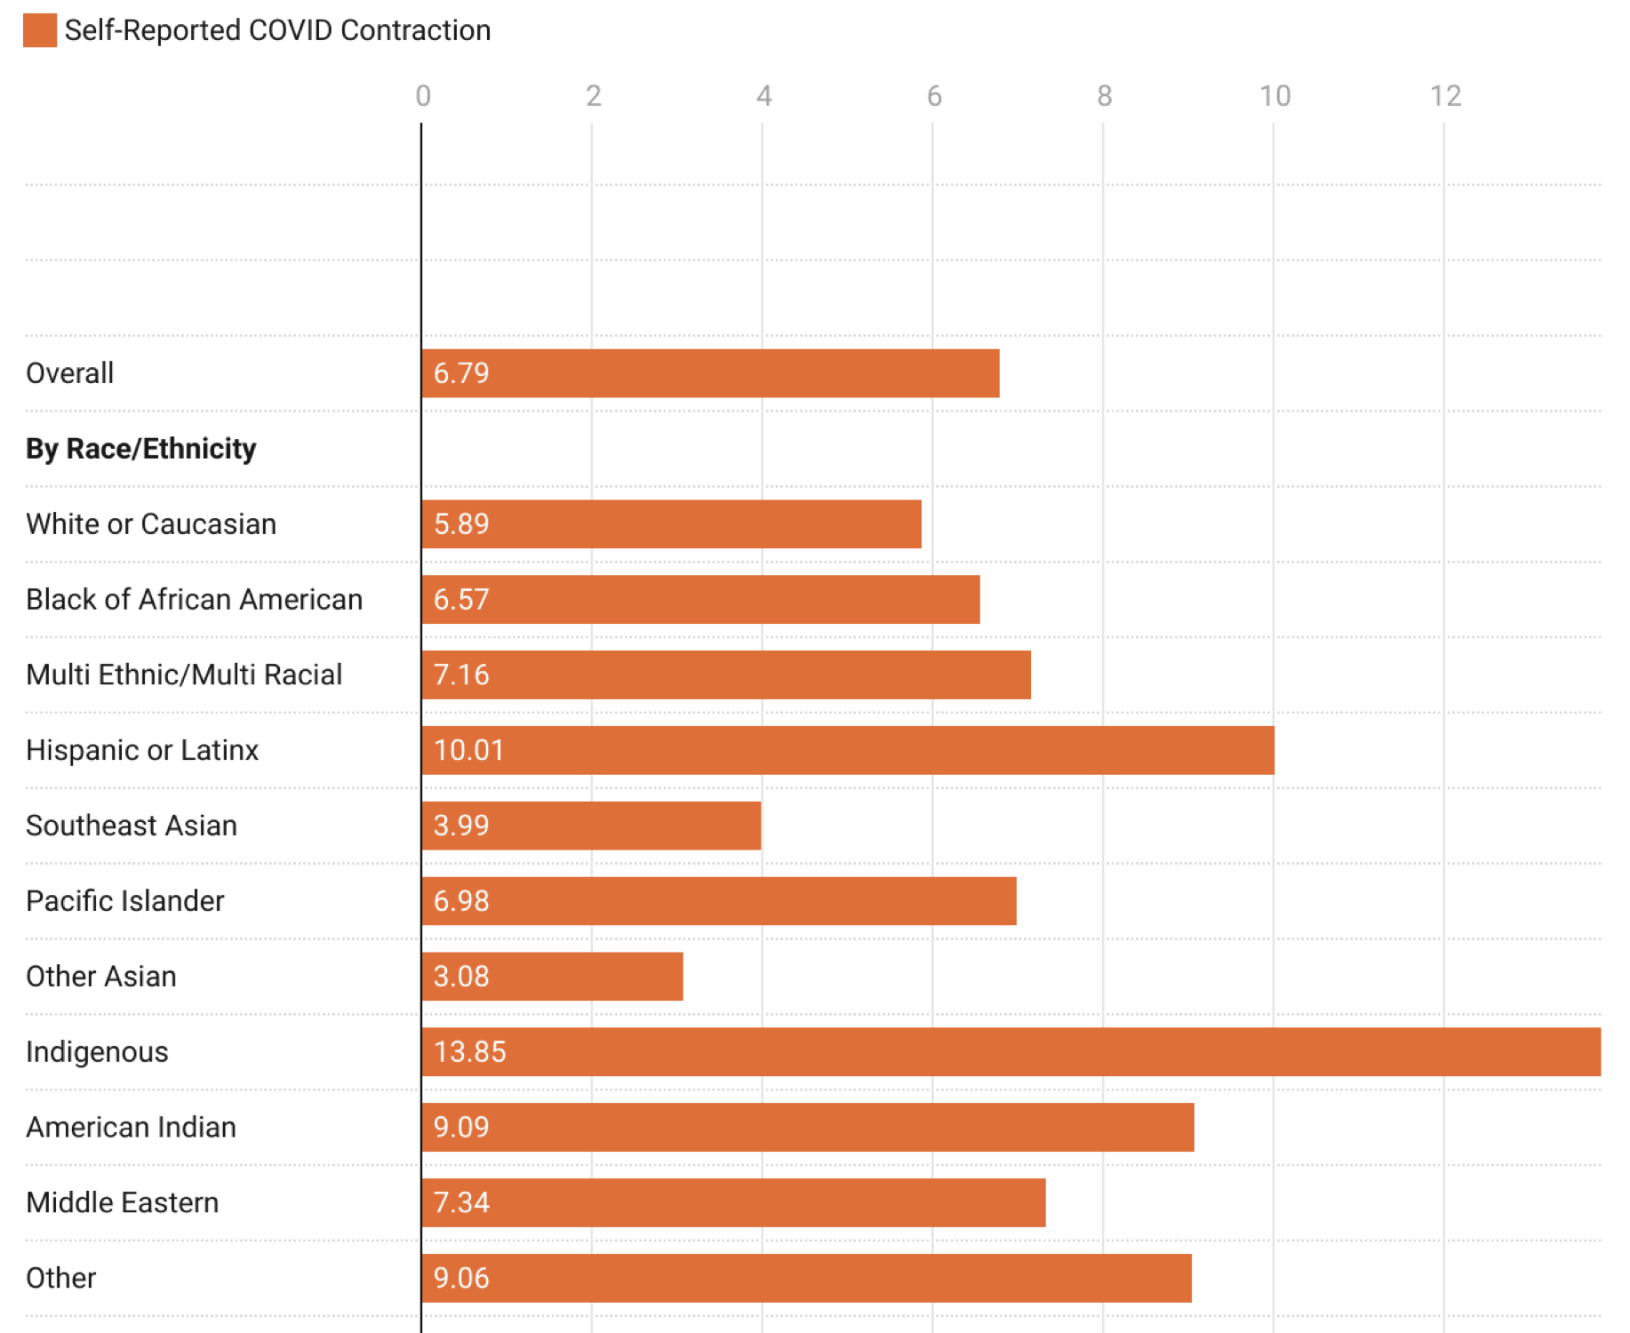
Where Are We Now?
➤
COVID Infection, Mental Health, & Food Insecurities
7% of students indicated a COVID infection
COVID infection associated with food insecurities, anxiety, depression
➤
➤
➤
➤
➤
➤
➤
➤
➤
➤
( The Hope Center, 2021; 100,000 students, Fall 2020, Self-report )

Slide 8
Where Are We Now?
COVID Infection, Mental Health, & Food Insecurities
Overall, 7% of students indicated a COVID infection
COVID infection was associated with
Food Insecurities 1.7 (odds)
Anxiety 1.3 (odds)
Depression 1.4 (odds)
( The Hope Center, 2021; 100,000 students, Fall 2020, Self-report )

Slide 9
Where Are We Now?
The pandemic has been disproportionately challenging for:
Students of Color
Queer Students
Students of Low-Income Families

Slide 10
New Cases 7-Day Average
?
Jan 2020 Mar June Sept Jan 2021 Apr July Oct Dec
Spring 2020
Fall 2020
Spring 2021
Fall 2021

Slide 11
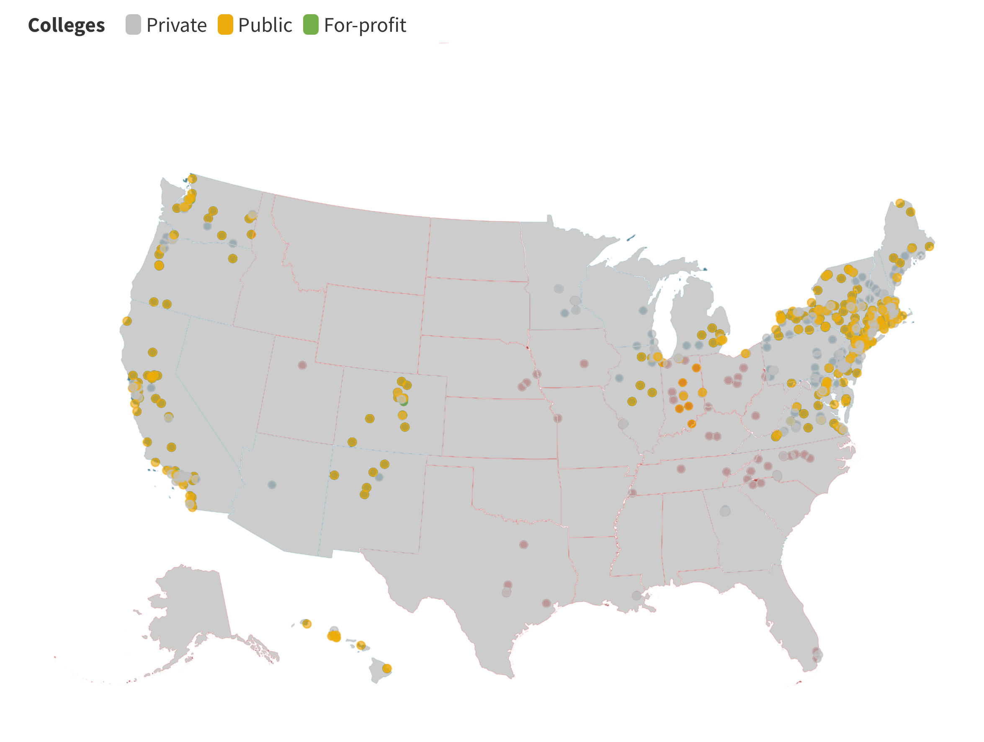
Colleges & Universities Requiring Masks (as of August 6th)

Slide 12
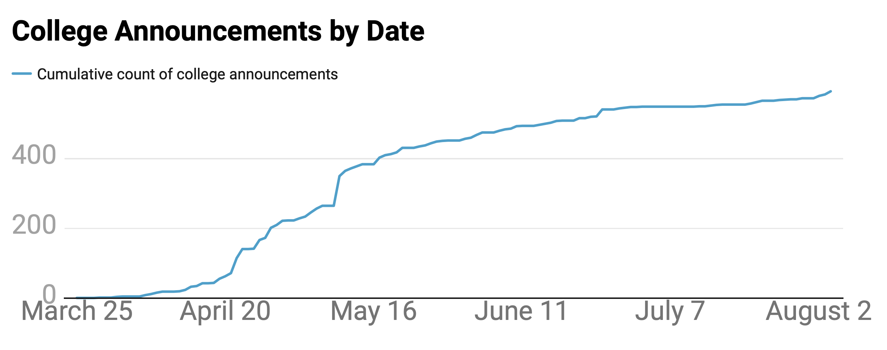

Slide 13
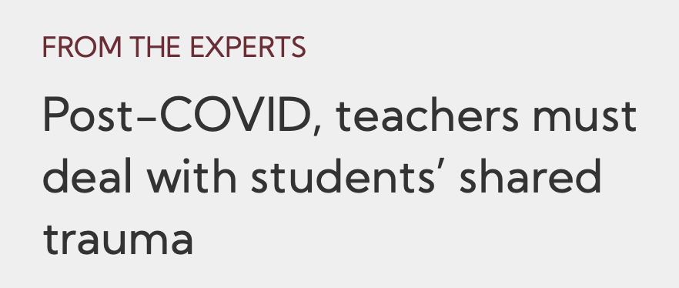
Educational Pundits

Slide 14
What’s Ahead?
5 Things to Stick with in the Future (Cowell, 2021)
Increase in instructional technology use
Engagement will be more than showing up
Traditional exams out; Open-book/resource tasks in
Students will actively contribute to the course
Pedagogically: Less lecture; More interaction

Slide 15
What’s Ahead?
3 Major Post-COVID Changes (Eades, 2021)
Increased focus on online degrees
Increased focus on instructional quality and relevance
Increased focus on instructional technologies

Slide 16
What’s Ahead?
Who knows what the future will hold?
You Do.

Slide 17
Survey (IRB Approved)
1. Considering your COVID-based teaching over the past 18 months, what did you learn during that COVID teaching that you will apply in your fall 2021 course(s)?
2. As we move toward classes in the fall, keeping in mind your experiences over the past 18 months, what can we do to better support our students' learning?
1. Considering your COVID-based teaching over the past 18 months, what did you learn during that COVID teaching that you will apply in your fall 2021 course(s)?
2. As we move toward classes in the fall, keeping in mind your experiences over the past 18 months, what can we do to better support our students' learning?

Slide 18
Survey Demographics
115 Responses (from 436 requests; 26% response rate)
68 females, 43 males, 4 non-binary
89 White, 11 Black, 5 Asian
49 years old (average)
17 years of experience (average)

Slide 19
Survey Demographics
115 Responses (from 436 requests; 26% response rate)
45 Social Sciences • 14 1-15 Students
36 Physical Sciences • 78 15-30 Students
24 Liberal Arts • 11 31-50 Students
• 11 50+ Students

Slide 20
Emergent Themes
Students Have Lives, Respect Them
Actively Supporting Students’ Mental Health
Employ (More) Engaging Instructional Methods
Contact, Communication, & Caring

Slide 21
Students’ Have Lives
Students’ lives beyond the class interact with their class performance, included various responsibilities:
Caretaker
Healthcare
Childcare
Financial
Employment

Slide 22
My students have caretaker (children & elderly) responsibilities.
It’s important to be empathetic towards all the ups and downs in their lives.

Slide 23
Be as flexible as possible because students have a lot going on and juggle many priorities.
Being flexible about deadlines and personal issues with students. They really struggled and we never really know the whole story.

Slide 24
Give them a sense of agency and voice in not only their learning, but in their lives.
Provide them with choices – whether that is how to do their work or a menu of options from which to choose.

Slide 25
Responsibilities
Agency
Empathy
Flexibility

Slide 26
Students’ Mental Health
Students’ mental health need to be foregrounded as it impact students’ well being, as well as their class performance.
Emotional Well-being
Psychological Well-being
Social Well-being

Slide 27
I had students who had to drop classes because of mental health issues.
Students were isolated, anxious, and depressed. I had students who were homeless.

Slide 28
I was reminded about the importance of making every space a safe space for students for their learning to occur.
Providing a safe space for students to share concerns and issues, both academically and personally.

Slide 29
Check-in with students periodically regarding mental health and well-being.
Regularly check on students’ mental health and well-being. Provide direct opportunities to interact individually with the instructor.

Slide 30
Students are still emotionally unsteady and need emotional support. I will be providing a listening ear and suggest support services.
Many students experienced heightened mental health challenges that impacted their persistence and success in classes. We need greater partnerships among support services to ensure that mental health services are available to all our students.

Slide 31
Empathy
Support Services
Safe Spaces
Check-In

Slide 32
Engaging Instructional Methods
Foster student learning by engaging students through active learning instructional strategies, such as:
Class Presentations • Discussions
Open-ended Questions • Group Projects
Problem-based Learning • Peer Learning
Team-based Learning • Small-group Tutoring
Cooperative Learning • Review Quizzes

Slide 33
Get them more actively engaged and be engaged with them.
I learned that my students were faced with different challenges, and I had to reach each one of them and work out a plan to engage them in their learning process.

Slide 34
A ‘flipped classroom’ model of requiring advance readings and responses will serve everyone better to liberate the precious time spent together for more quality interaction.
I really learned how little the students need a lecture from me. I’m going . . . to make the lecture an out of class review, and the class about applying concepts.

Slide 36
I will definitely include a much wider variety of learning activities – those including technology, but also work to maximize the impact of in-class learning sessions.
I think we need to continue to work to maximize learning while considering the individual needs of each student.

Slide 37
Flexibility
Learning
Engagement
Flipped Class

Slide 38
Communication & Caring
Students’ sense of loneliness, stress, and anxiety can be addressed through the development of a caring community.
Small Things Matter
Trauma Happened
Self-Care
Compassion

Slide 39
I also feel that shared experiences let them know that they are not alone, that others face struggles as well and that we can support each other in our efforts to improve our learning.
I think taking time to validate and process students’ stress levels would be helpful. Students like to learn that others are experiencing the same as them and they feel heard when the instructor takes time to process those stressors.

Slide 40
There is a need for re-establishing culture, community, and in-person teamwork with students who have been largely behind screens for quite some time.
I will continue working as much as I can with the idea of creating a community in the classroom where we all become more aware of what we all go through when we face situations like the pandemic.

Slide 41
Instead of answering questions through email exchanges, I plan on using Zoom meetings a LOT more to have quality discussions with students outside of class.
I have noticed that students respond much better to virtual office hours . . . . This option can give students the opportunity to ask questions they might not ask.

Slide 42
Agency
Questions & Answers
Shared Experiences
Community

Slide 43
Emergent Themes
Students Have Lives, Respect Them
Actively Supporting Students’ Mental Health
Employ (More) Engaging Instructional Methods
Contact, Communication, & Caring

Slide 44
At the end of the day, I believe a great many faculty provided excellent instruction these last 18 months.

Slide 45
Before We Go . . .
“Normal” was not always the best – we know better now, so we should do better.
Uncertainty remains.

Slide 46
Reassessing, Reimagining, Recalibrating
Teaching and Learning
Peter E. Doolittle
Virginia Tech
pdoo@vt.edu @pdoodoo peter-doolittle
Unsplash for Photos ☺︎ VectorStock for Icons

