Slide 1
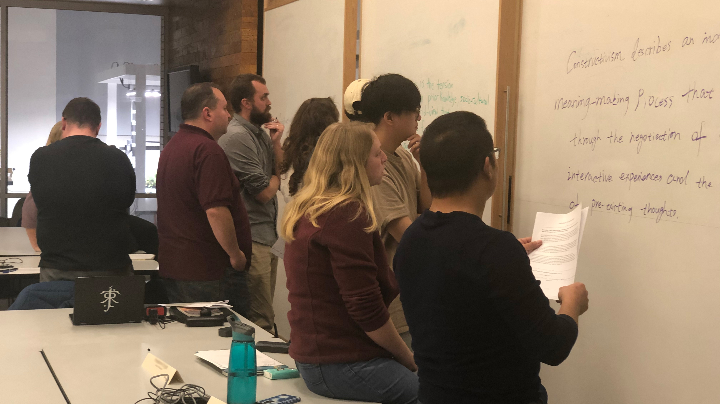
Active Learning Proactive Teaching
2022 Teaching and Learning Symposium • 2022 Teaching & Learning Talks (TLTs) – The Science of Learning
Peter E. Doolittle Professor, Educational Psychology Virginia Tech
pdoo@vt.edu (email) • pdoopdoo (twitter) • peter-doolittle (linkedin) • peterdoolittle.org (web)

Slide 3
What is Active Learning?
What is active learning?
(in one sentence)
Notes:
Gather descriptors, then do a voting protocol

Slide 4
Today’s Mantra
What we process we learn.

Slide 5
Cognitively
(thinking)
Behaviorally
(doing)
Engagement
Active Learning
Interactive Learning
Hands On
What we process
we learn.
Affectively
(emoting)
Socially
(interacting)

Slide 6
Active Learning

Slide 7
Defining Active Learning Is Like . . .

Slide 8
Freeman et al. (2014)
Research Methodology
Active learning courses (AL) vs traditional lecture courses (TL)
Systematic review of UG STEM courses (meta-analysis)
Exam scores and Passing Rates (DFW)
.47 SD increase on exam scores ( 6% difference)
DFW rate: AL = 21.8%; TL = 33.8% (12% difference)
Greatest effects in smaller classes (< 50 students)

Slide 9
Freeman et al. (2014)
Defining Active Learning
Active learning engages students in the process of learning through activities and/or discussion in class, as opposed to passively listening to an expert. (p. 8413)

Slide 10
Freeman et al. (2014)
6%
lecture
everything else
passive
active
This study’s intent was to evaluate the average effect of any active learning type . . . contrasted with traditional lecturing. (p. 8414)

Slide 11
Freeman et al. (2014)
First Generation AL Research
Active learning strategies vs Traditional lecture
Second Generation AL Research
Active learning strategy vs Active learning strategy
Active learning strategy and specific students, teachers, topics, environments, outcomes
see also Bernstein (2018), Daniel & Poole, 2009; Martella et al., 2020; Streveler & Menekse, 2017

Slide 12
Other Good Active Learning Articles
Bonwell & Eison (1991)* Active learning: Creating Excitement
Deslauriers et al. (2019) Measuring active learning
Driessen et al. (2020) Demystifying Active Learning
Freeman et al. (2014)* Active learning increases performance
Hake (1998)* Interactive engagement methods
Lombardi et al. (2021) The curious construct of active learning
Martella et al. (2020) Effects of Active Learning Implementations
Nguyen et al. (2021) Instructor Strategies
Prince (2004)* Does active learning work?
Theobald et al. (2020) Active learning narrows achievement gap

Slide 13
Some Other General Findings
Active learning increases academic achievement and decreases DFWs for underrepresented students in STEM classes (narrows achievement gaps). (Theobald et al., 2020)
Students often perceive engaging in active learning as resulting is less learning than engaging in lecture. (Deslauriers et al., 2019)
Notes:
Something about preferences? Redo this slide. Too difficult to read and understand.

Slide 14
Some Other General Findings
Active learning increases academic achievement and decreases DFWs for underrepresented students in STEM classes (narrows achievement gaps). (Theobald et al., 2020)
Students often perceive engaging in active learning as resulting is less learning than engaging in lecture. (Deslauriers et al., 2019)
Notes:
Something about preferences? Redo this slide. Too difficult to read and understand.

Slide 15
Some Other General Findings
Active learning has a greater impact on student achievement in lower-level/introductory classes, as compared to advanced classes.
Active learning has a greater impact on students with higher prior knowledge.
Notes:
Something about preferences? Redo this slide. Too difficult to read and understand.

Slide 16
Reality Check
Extra time for course (re)design
Extra time in class for AL strategies
Resistance from students and teachers
Classroom control and management
Lack of appropriate classroom spaces
Possibility that AL strategies won’t work

Slide 17
What is Active Learning?
How does published research define AL?
Articles Addressing Inclusion Criteria →
No Definition
Definition
Driessen et al., 2020
Biology Ed
2016-2018
148 articles
83.5%
16.5%
Doolittle et al., 2022
Across Domains
2017-2022
586 articles
70.1%
29.9%
Notes:
Dreissen: Top 2 Strategies: Discussion, Group Work Top Definition: Engaging and interacting
Doolittle: Top 2 Strategies: Group Work, Problem Solving Top Definition: ? ? ?

Slide 18
What is Active Learning Domains
accounting
biology
biomedical education
calculus
chemical education
chemistry
computer science
construction management
cybersecurity
economics
education
engineering
English as a FL
geosciences
health sciences
Info technology
library science
mathematics
medical education
moral education
nutrition education
pharmacy education
philosophy
physical therapy
physics
political science
quantum field theory
recreational therapy
STEM
transportaion
Active learning isn’t domain specific.

Slide 19
What is Active Learning? Strategies
case-based learning
clickers
concept-point-recovery
controversial issues
cooperative learning
debate
design-based learning
discussion
dramatization
films
flipping
focused listening
group work
inquiry-based learning
jigsaw
laboratory learning
minute papers
music
online forums
peer instruction
problem-based learning
questioning
reflection journals
role play
serious games
service learning
simulations
social media
student presentations
team-based learning
Active learning isn’t a strategy.
Notes:
48% of definitions were ”definition by strategy”

Slide 20
What is Active Learning? Strategies
case-based learning
clickers
concept-point-recovery
controversial issues
cooperative learning
debate
design-based learning
discussion
dramatization
films
flipped classroom
focused listening
group work
inquiry-based learning
jigsaw
laboratory learning
minute papers
music
online forums
peer instruction
problem-based learning
questioning
reflection journals
role play
serious games
service learning
simulations
social media
student presentations
team-based learning
Active learning effectiveness depends on implementation.
(active learning is not magic)

Slide 21
What is Active Learning Domains
accounting
biology
biomedical education
calculus
chemical education
chemistry
computer science
construction management
cybersecurity
economics
education
engineering
English as a FL
geosciences
health sciences
Info technology
library science
mathematics
medical education
moral education
nutrition education
pharmacy education
philosophy
physical therapy
physics
political science
quantum field theory
recreational therapy
STEM
transportaion
To date, the active learning literature provides no unambiguous guidance to instructional designers who would like to ground their teaching methods in active learning.
-- (Martella et al., 2020)

Slide 22
Cognitively
(thinking)
Behaviorally
(doing)
Engagement
Active Learning
Interactive Learning
Hands On
Active learning is deep and flexible
cognitive, behavioral, social, and/or affective processing
of one’s new and prior knowledge and experience.
What we process
we learn.
Affectively
(emoting)
Socially
(interacting)

Slide 23
Cognitively
(thinking)
Behaviorally
(doing)
What we process
we learn.
Affectively
(emoting)
Socially
(interacting)

Slide 24
Cognitively
(thinking)
Behaviorally
(doing)
What we process
we learn.
Affectively
(emoting)
Socially
(interacting)

Slide 25
Active Learning in Action

Slide 26
Word Pairs
Falling Snow
Laughing Child
Friendly Wolf
Picture Frame
Cold Food
Bright Sun
Writing Poetry
Windy Day
Quiet Forest
Big Airplane
Walking Tiger
Blue Sky
That’s it!

Slide 27
Let’s See What You Remember
Falling _____
Blue _____
Quiet _____
Friendly _____
Picture _____
Walking _____
_____ Sun
_____ Poetry
_____ Day
_____ Child
_____ Airplane
_____ Food
That’s it!

Slide 28
Long Term Memory
Performance
1
2
3
4
# of
Vowels
Repeat
5 Times
Write a
Sentence
Mental
Image
Groups
Notes:
Meaning

Slide 29
Active Learning and Cognitive Processing
Meaningful Learning & Elaborative Learning
Connecting new to prior knowledge increases retention.
Connecting prior to new knowledge increases retention.
Testing Effect & Generate Effect
The act of retrieving knowledge increases retention.
The act of generating meaning increases retention.
Retrieval Practice

Slide 30
Active Learning and Cognitive Processing
Spacing Effect & Interleaving Effect
Distributing retrieval of knowledge over time increases retention.
Interlacing the retrieval of knowledge increases retention
Prior Knowledge Growth & Self-Regulated Learning
Increasing advance prior knowledge increases generalization.
Practicing the planning, enacting, monitoring, and evaluating of engagement increases the control of knowledge.

Slide 31
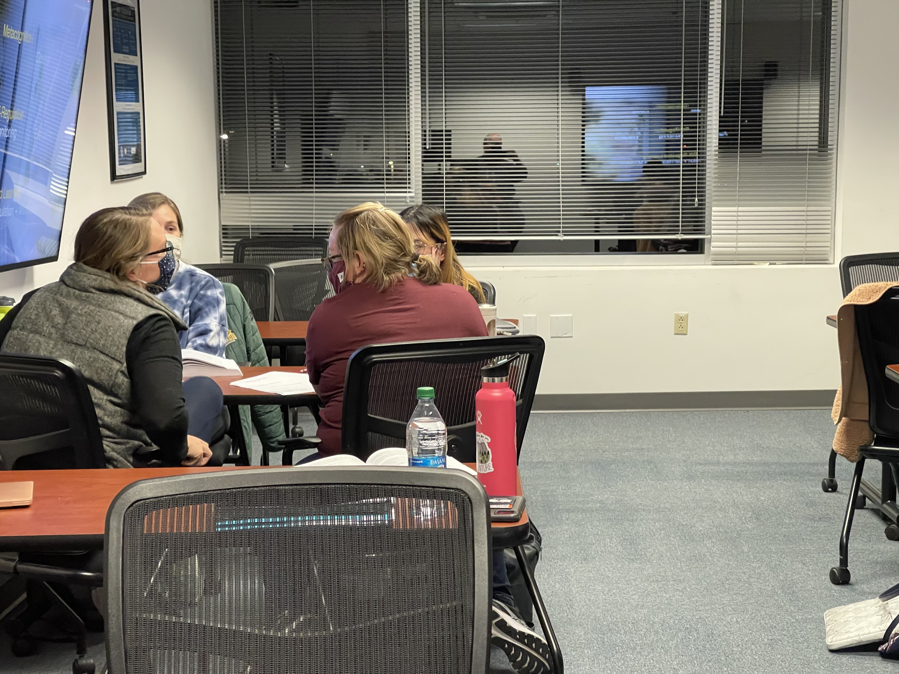
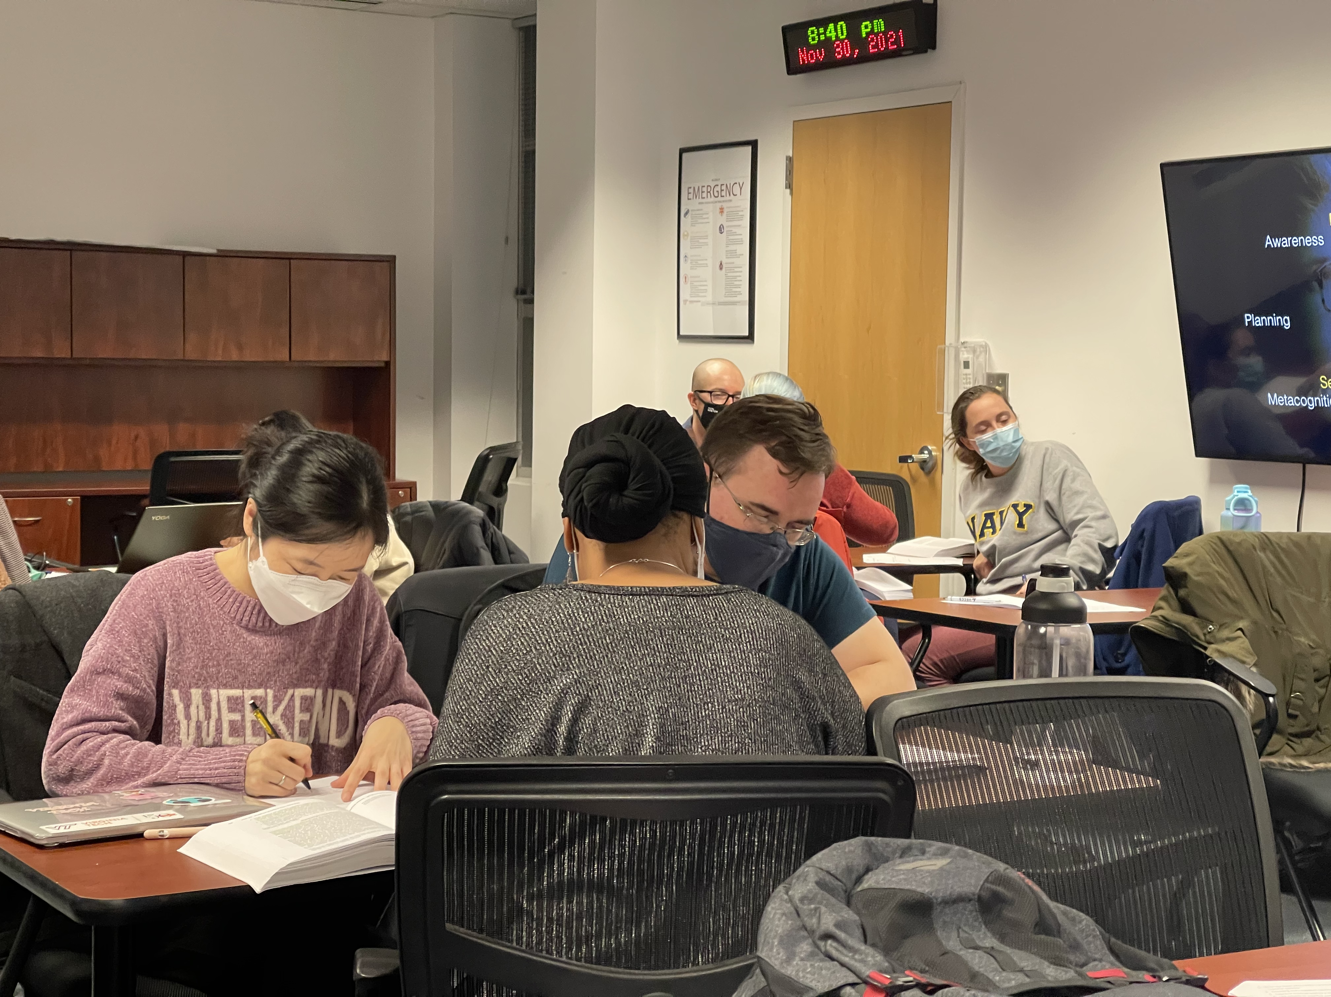
Active Learning and Cognitive Processing
Early Knowledge Acquisition
Small Group Work – Jigsaw
Meaningful
Learning
Elaborative
Learning
Retrieval
Practice
Testing Effect
Generate
Effect
Spacing
Effect
Interleaving
Effect
Prior Knowledge
Growth
Self
Regulation
Learning

Slide 32
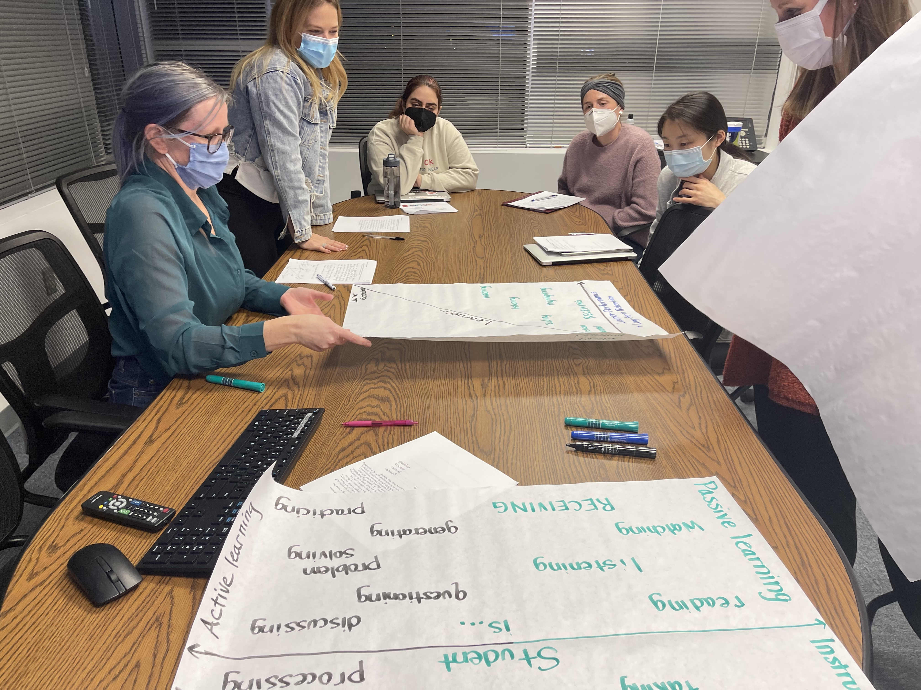
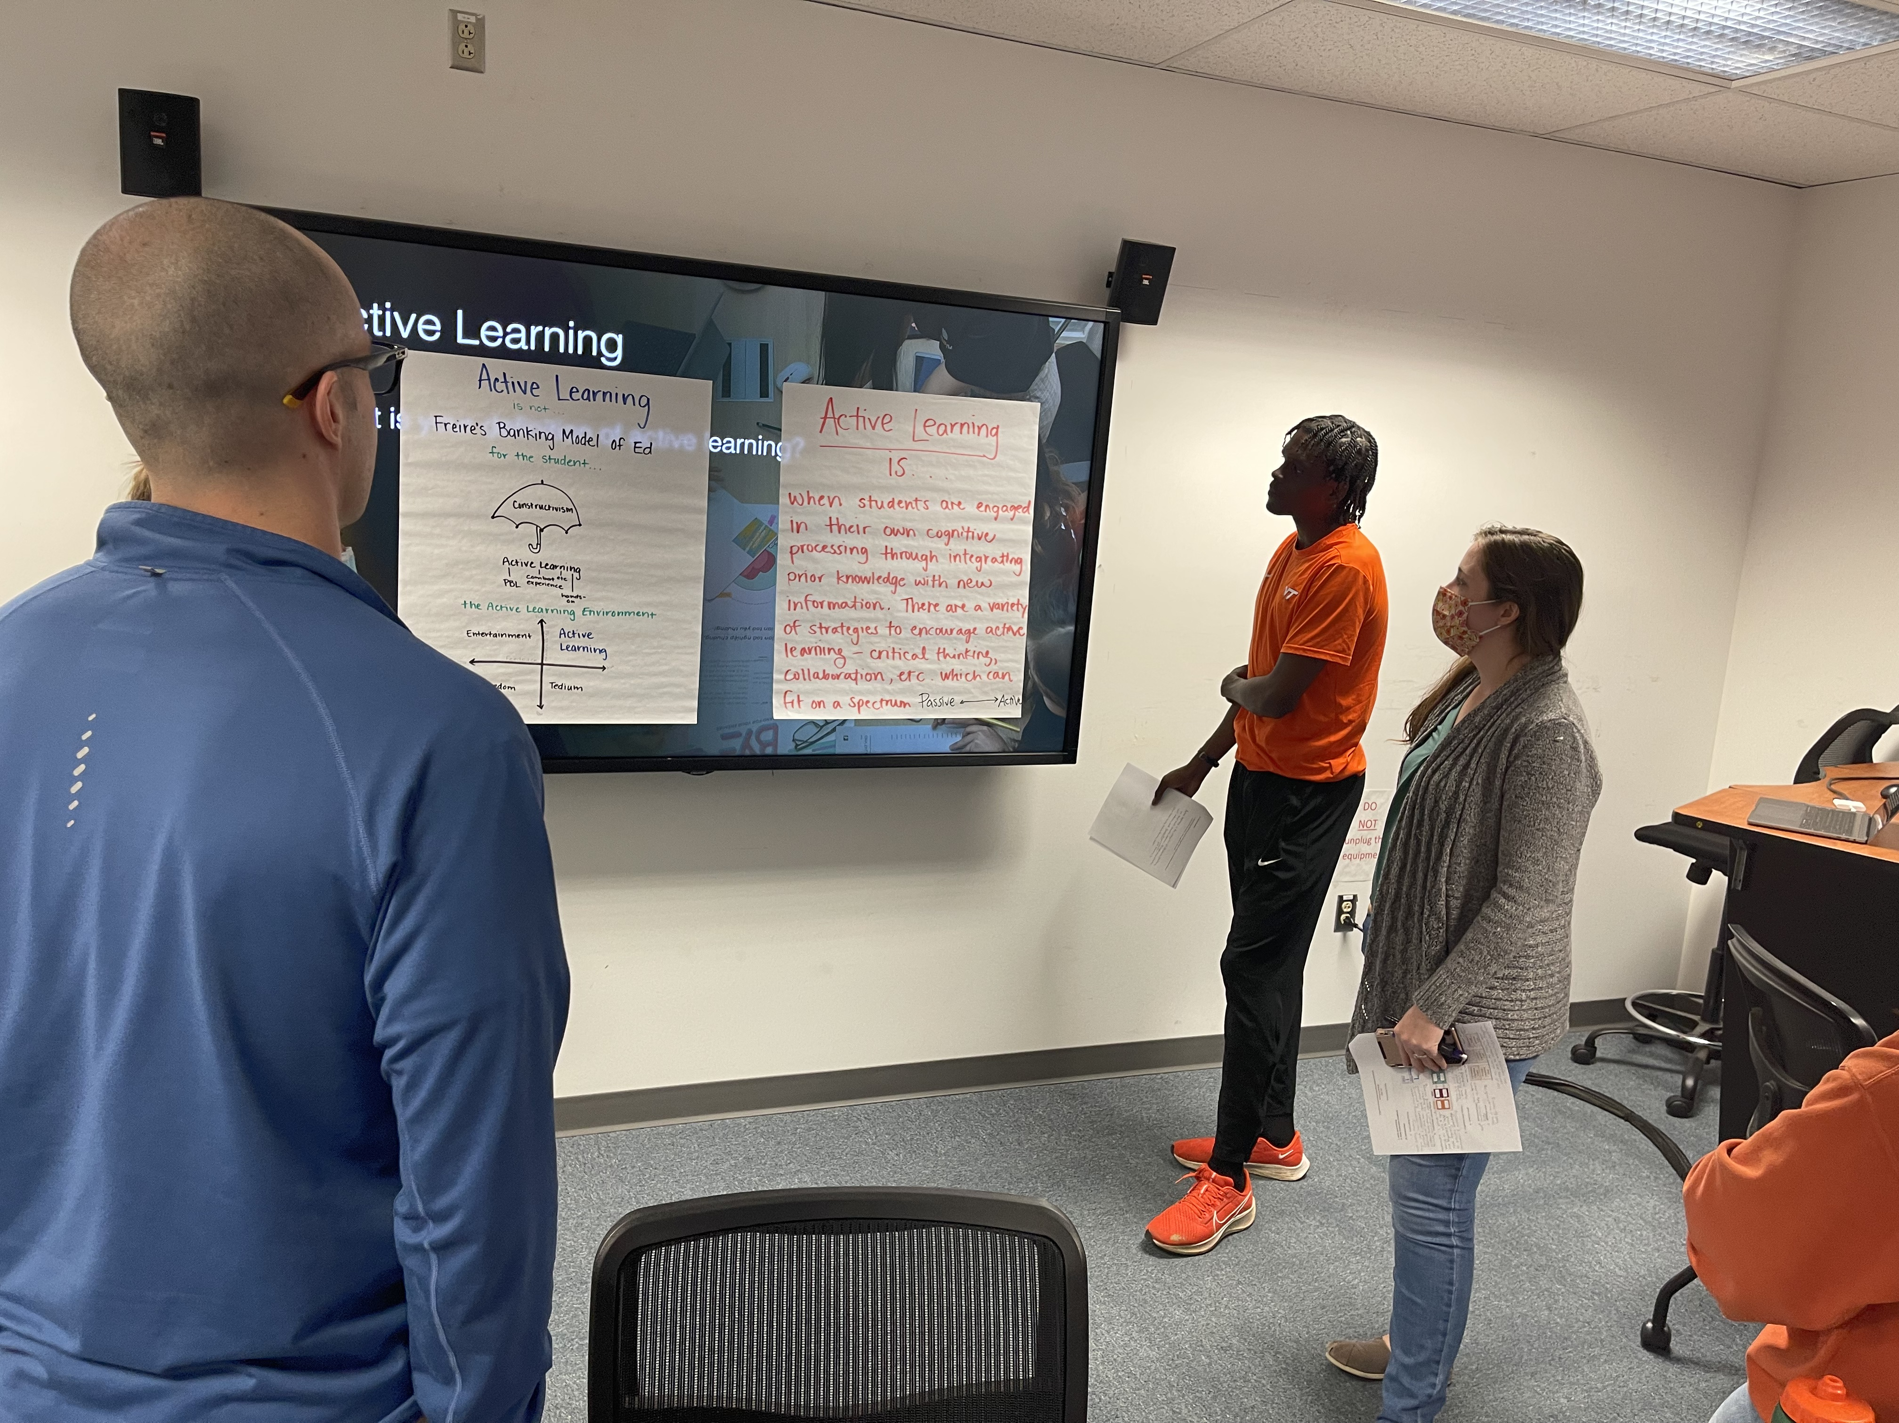
Active Learning and Cognitive Processing
Organizing and Synthesize Knowledge
Small Group to Large Group Project
Meaningful
Learning
Elaborative
Learning
Retrieval
Practice
Testing Effect
Generate
Effect
Spacing
Effect
Interleaving
Effect
Prior Knowledge
Growth
Self
Regulation
Learning

Slide 33
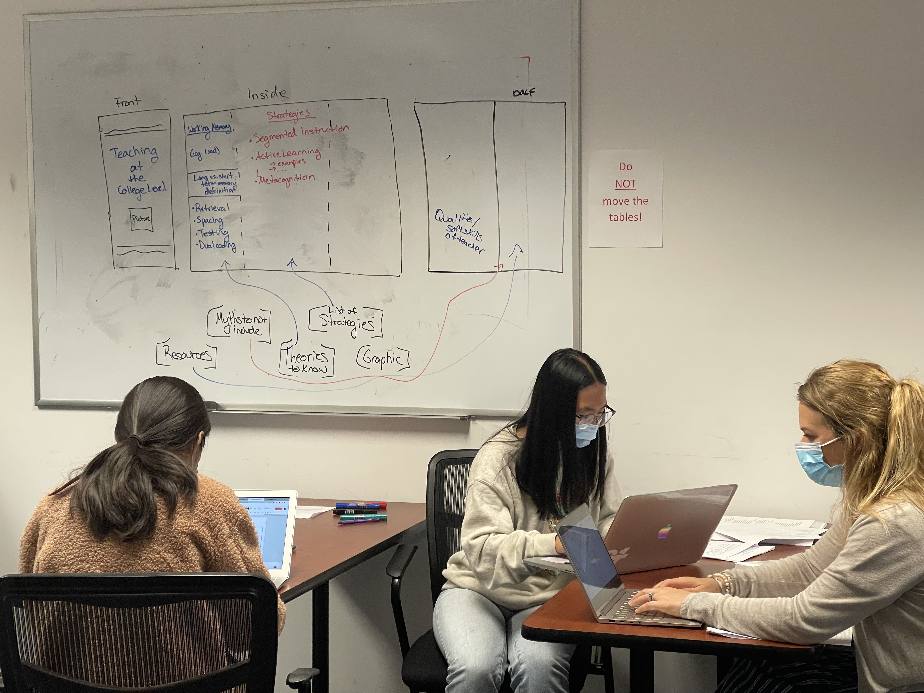
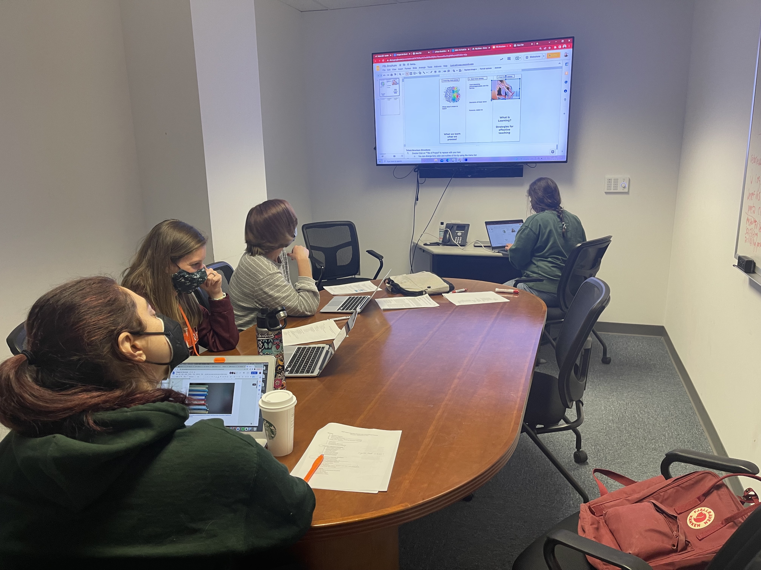
Active Learning and Cognitive Processing
Analyze, Synthesize, and Create
Problem-Based Learning
Meaningful
Learning
Elaborative
Learning
Retrieval
Practice
Testing Effect
Generate
Effect
Spacing
Effect
Interleaving
Effect
Prior Knowledge
Growth
Self
Regulation
Learning

Slide 34
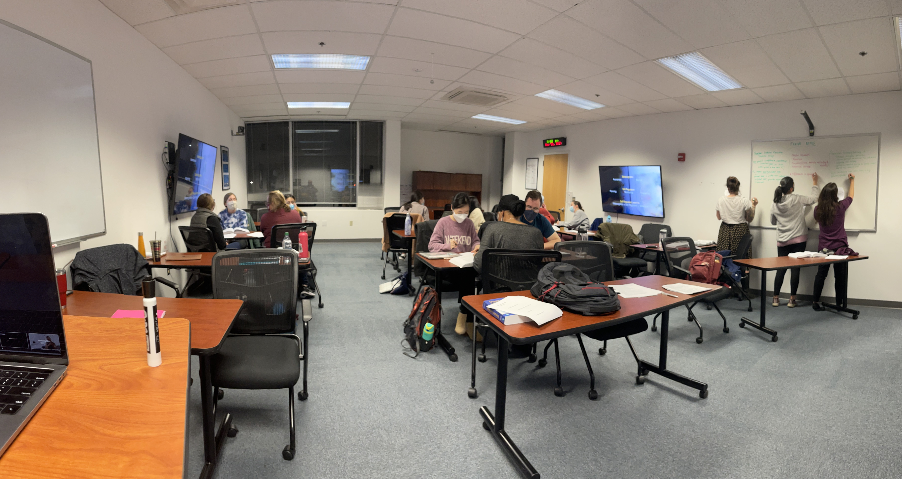
Active Learning and Cognitive Processing
What we process we learn.
Outcome → Processing → Strategy
Meaningful
Learning
Elaborative
Learning
Retrieval
Practice
Testing Effect
Generate
Effect
Spacing
Effect
Interleaving
Effect
Prior Knowledge
Growth
Self
Regulation
Learning

Slide 35
Active Learning Proactive Teaching
2022 Teaching and Learning Symposium • 2022 Teaching & Learning Talks (TLTs) – The Science of Learning
Peter E. Doolittle Professor, Educational Psychology Virginia Tech
pdoo@vt.edu (email) • pdoopdoo (twitter) • peter-doolittle (linkedin) • peterdoolittle.org (web)

