Slide 1
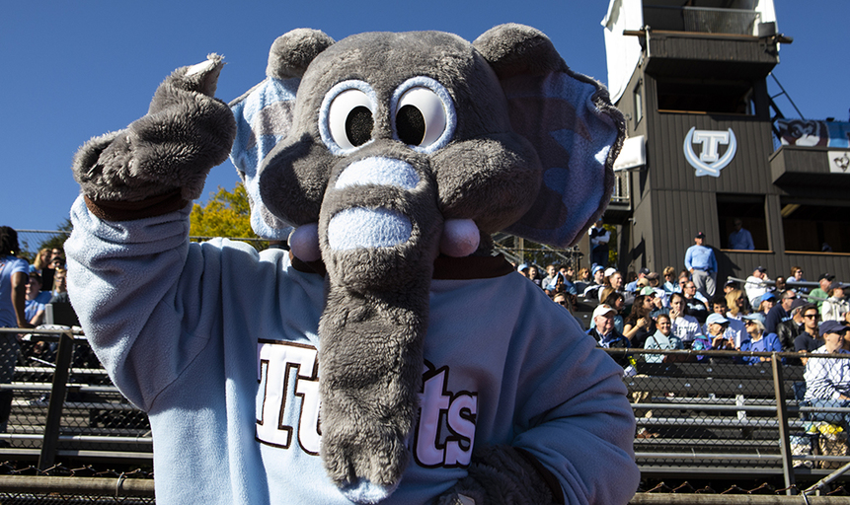
Active Learning
Experience ‣ Knowledge ‣ Meaning
IRACDA
Peter Doolittle
Educational Psychology
Virginia Tech
pdoo@vt.edu

Slide 2
Hello
Community over Content

Slide 3
Agenda
Active Learning
to Proactive Teaching

Slide 4
Anticipation Guide
Directions: For each of the following 3 sentences,
Agree
Disagree
Edit into agreement

Slide 5
Anticipation Guide
Active learning involves students doing things and thinking about the things they are doing.
Active learning-based classes result in more student learning than lecture-based classes.
Active learning fosters greater learning in small STEM classes focused on problem solving.

Slide 6
A Change in Perspective

Slide 7
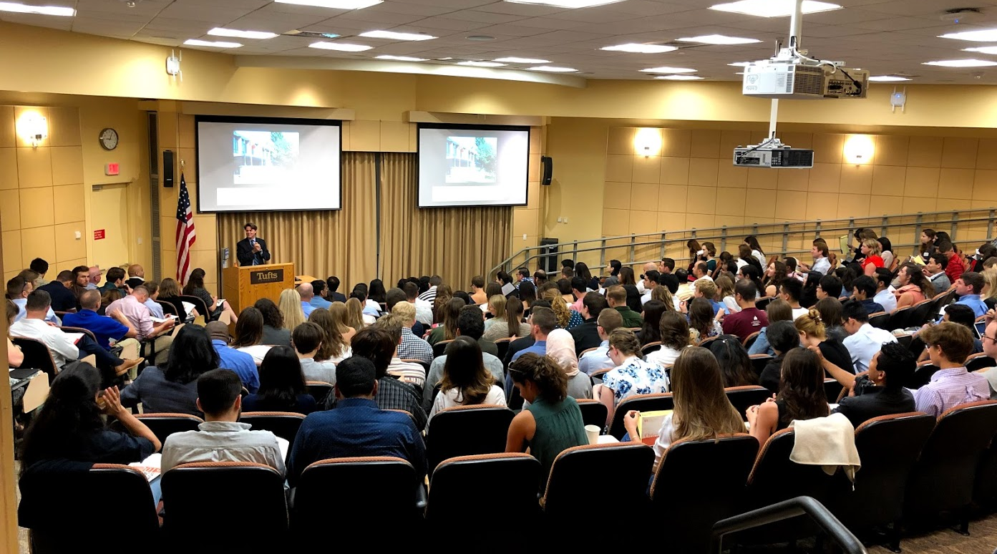
Presenting vs Teaching

Slide 8
To what degree do you, as the teacher, take responsibility for students’ learning?
On a scale of 0 to 100%.
presenting
teaching
responsibility for learning

Slide 9
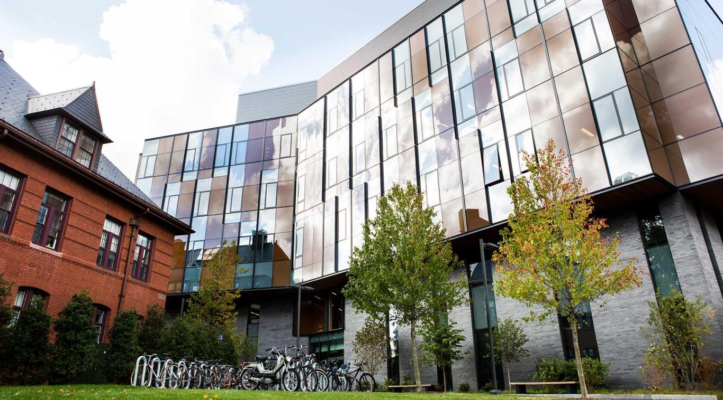
Active Learning: A Changing Perspective

Slide 10
What is Active Learning?
Write down 1-2 words that describe active learning.

Slide 11
What is Active Learning?
Freeman et al. (2014)
Active Learning vs Lecture Courses
UG STEM Courses
Exam Scores & DFW Rates
AL → ↑ Exams & ↓ DFWs
Theobald et al. (2020)
Active Learning vs Lecture Courses
UG STEM Courses
Exam Scores & DFW Rates
AL → ↑ Exams & ↓ DFWs
Larger gains for students from underrepresented groups (narrowed achievement gap)

Slide 12
What is Active Learning?
Lecture
Active Learning
passive
active
Novice vs Experts
Declarative Knowledge vs Procedural Knowledge
Under-Represented vs Over-Represented
Math vs Engineering vs Biology vs Physics

Slide 13
Active Learning Research
First Generation Does Active Learning Work?
Second Generation For Whom? When? Why? Domains?
✓
✗
( Bernstein, 2018; Freeman et al., 2014; Streveler & Menekse, 2017 )
)

Slide 14
What is Active Learning?
Active learning fosters strong and flexible knowledge through
cognitive, social, behavioral, and affective processing
of one’s knowledge and experience.
strong and flexible knowledge
processing
knowledge and experience
Notes:
strong = easier to retrieve; hard to interfere with
flexible = connect to other knowledge, both within and across domains

Slide 15
Cognitive
(thinking)
Behavioral
(doing)
What we process
we learn.
Affective
(emoting)
Social
(interacting)

Slide 16
Active Learning
to Proactive Teaching

Slide 18
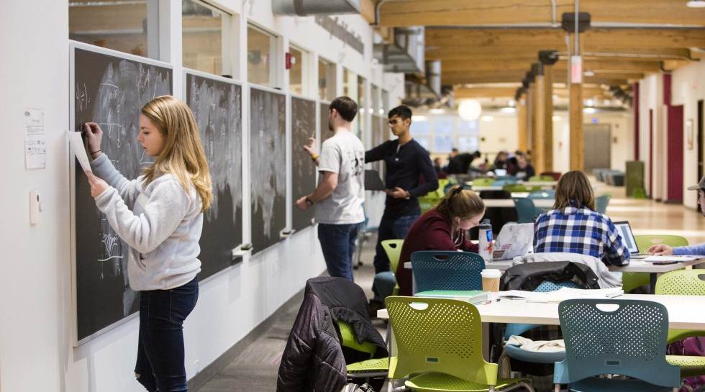
Debriefing the Anticipation Guide

Slide 19
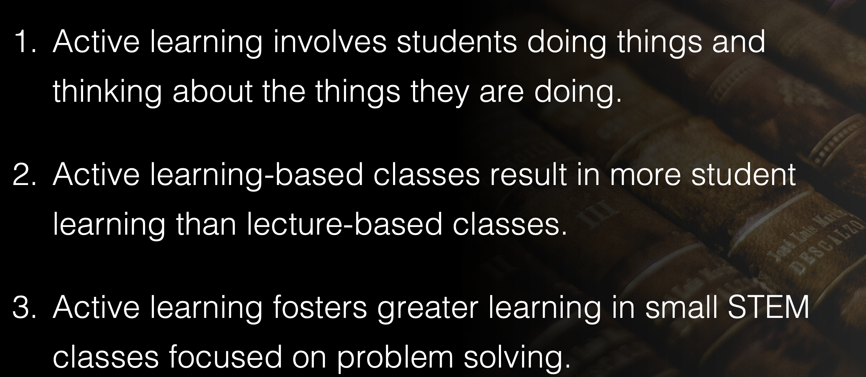
Debriefing the Anticipation Guide

Slide 20
Debriefing the Anticipation Guide
Technical
It depends
Personal

Slide 21
Debriefing the Anticipation Guide
The first few minutes in class
dictate the remaining minutes in class.

Slide 22
Debriefing the Anticipation Guide
Activation
Priming
Spread of
Activation
Activation results in an increased level of stimulation of students’ prior knowledge.
Activated prior knowledge is more readily accessible for immediate processing.
Activated prior knowledge increases the activation of closely related knowledge.
(Collins & Luftus, 1975; Grolbb-Mylnek et al.,2020; Schlosberg, 1954; Yerkes & Dodson, 1908)

Slide 23
active • learn • student • class
(Collins & Luftus, 1975; Grolbb-Mylnek et al.,2020; Schlosberg, 1954; Yerkes & Dodson, 1908)

Slide 24
Debriefing the Anticipation Guide
Activation
Priming
Spread of
Activation
Activate Relevant Prior Knowledge
Use Production-based Activities, NOT Reception-based Activities
Solve, answer, explain, discuss, apply
(Collins & Luftus, 1975; Grolbb-Mylnek et al.,2020; Schlosberg, 1954; Yerkes & Dodson, 1908)

Slide 25
Debriefing the Anticipation Guide
1 Minute Free Write
What do you see?

Slide 26
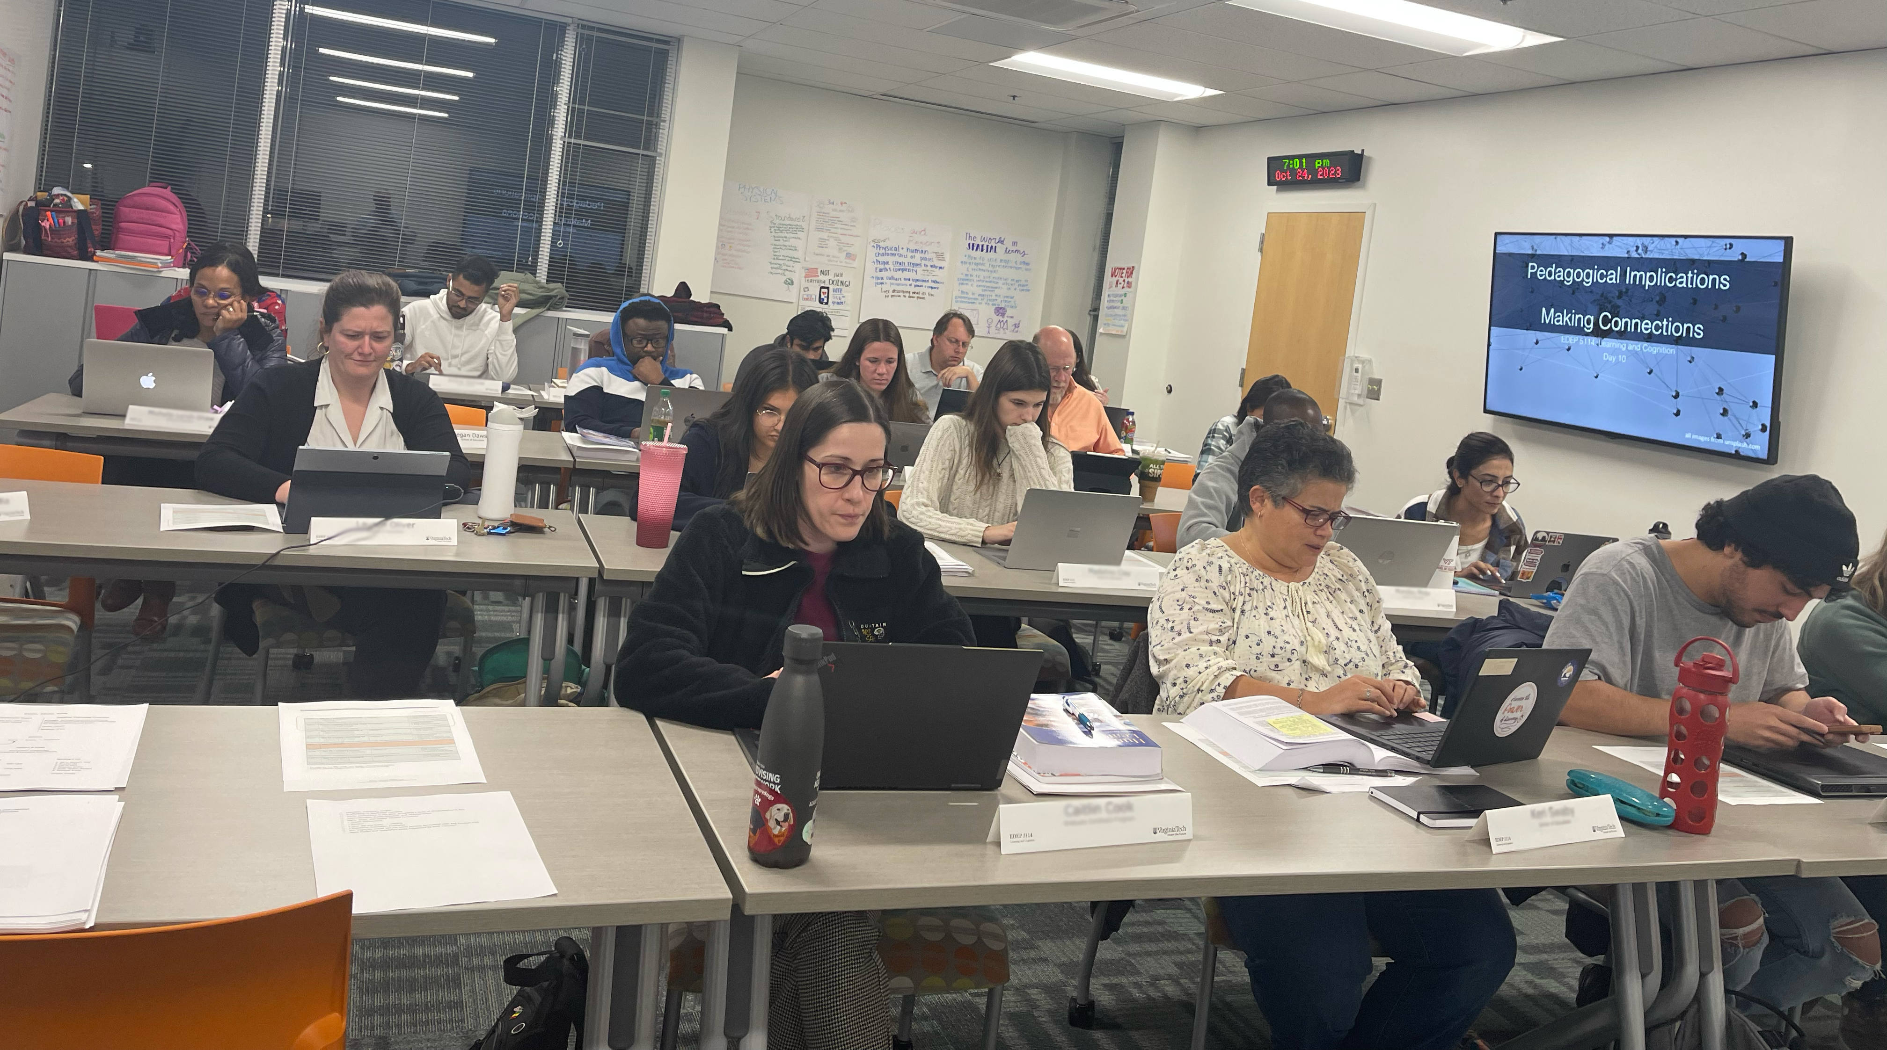
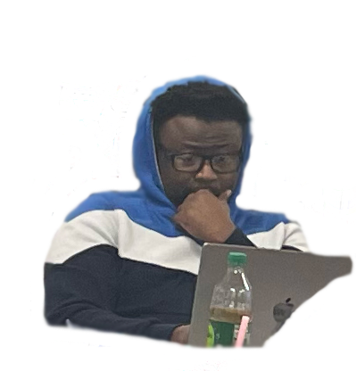
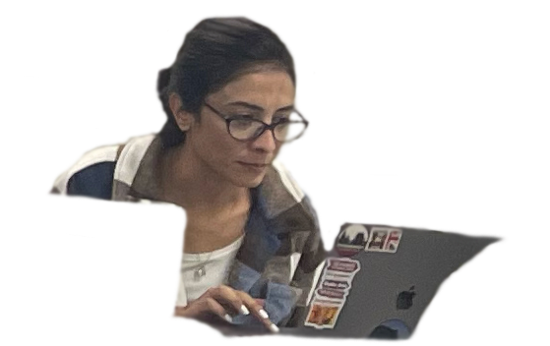
Debriefing the Anticipation Guide

Slide 27
Debriefing the Anticipation Guide
The first few minutes in class
dictate the remaining minutes in class.

Slide 28
Start Each Class with a Routine (5-15 min)
Hello
Priming Activity
Debrief End-of-Class Evaluation
Any Questions?
Review (Production, NOT Reception)
Introduction

Slide 29
End Each Class with a Routine (5-15 min)
Recall or apply the relevant content/skills
End-of-Class Evaluation (reflection & feedback
What aspects of the class are confusing?
What elements of the instruction were effective?
Comments/Thoughts?
Bye!
Closure

Slide 30
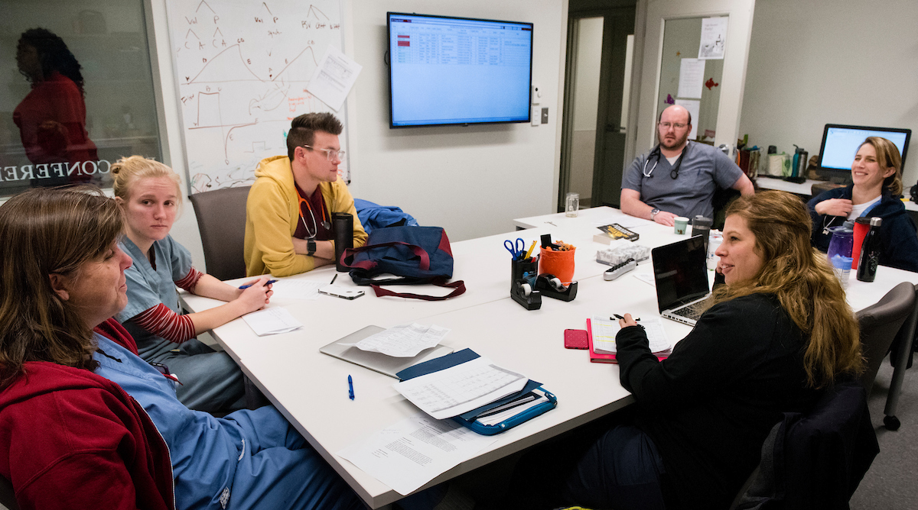
The Big Picture

Slide 31
The Big Picture of Active Learning
Teach Forward
Objectives Strategies Processing Connecting Meaning Learning
Plan Backward
What we process we learn.
Notes:
Halloween was invented in Ireland - 2,000 years to the Celtic Samhain (SAH-win) festival: usher in “the dark half of the year.”

Slide 32
Meaning & Learning

Slide 33
Meaning & Learning: Experiment
Directions . . .

Slide 34
Words
What do these results tell us about learning?
Rest
Tired
Awake
Dream
Snore
Bed
Eat
Slumber
Sound
Comfort
Wake
Night
Rest
Tired
Awake
Dream
Snore
Bed
Eat
Slumber
Sound
Comfort
Wake
Night
That’s all!

Slide 35
Meaning & Learning
Rest
Tired
Awake
Dream
Snore
Bed
Eat
Slumber
Sound
Comfort
Wake
Night
Conclusions
Connecting Fosters Meaning
Meaning Fosters Learning
Memory is Organized
Memory Imposes Limits

Slide 36
scíthe
tuirseach
dúiseacht
aisling
snor
leaba
ithe
pillín
fuaim
compord
úisigh
oíche
Rest
Tired
Awake
Dream
Snore
Bed
Eat
Slumber
Sound
Comfort
Wake
Night

Slide 37
Meaning & Learning
Understanding
Connecting → Meaning → Learning
New
Knowledge
Prior
Knowledge
Meaningful Learning NK → PK
Elaborative Learning NK ← PK
Integrated Learning PK ⚡︎ PK
Strong & Flexible
Notes:
Halloween was invented in Ireland - 2,000 years to the Celtic Samhain (SAH-win) festival: usher in “the dark half of the year.”

Slide 38
Make Some Meaning
Write a 1-sentence summary of this Meaning & Memory section.

Slide 39
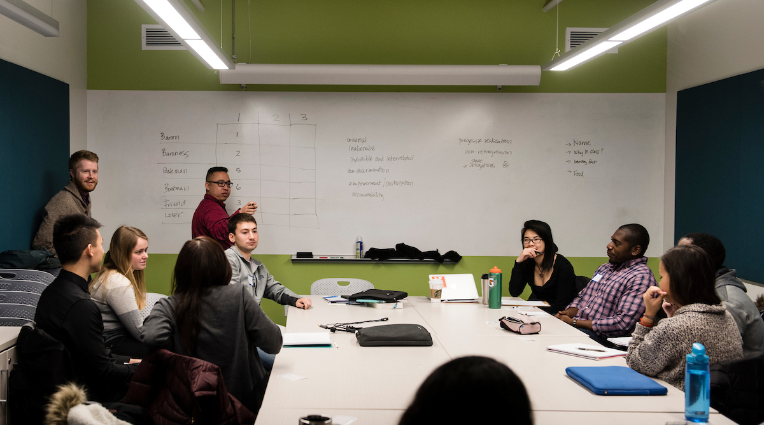
Active Learning: Strategies and Processing

Slide 40
Strategies and Processing: Experiment
Directions . . .

Slide 41
Strategies and Processing
What do these results tell us about learning?
10
8
6
4
2
0
1-10 11-20

Slide 42
Strategies & Processing
Evaluation
Image
Pronounce
Conclusions
Strategies Foster Processing
Processing Fosters Connecting
Connecting Fosters Meaning
Meaning Fosters Learning
Memory is Organized
Memory Imposes Limits

Slide 43
Strategies and Processing
Strategies → Processing → Connecting → Meaning → Learning
Cognitive
Behavioral
Social
Affective
Thinking
Doing
Interacting
Feeling
What we process
we learn.
How do we foster “connection”?
Notes:
Halloween was invented in Ireland - 2,000 years to the Celtic Samhain (SAH-win) festival: usher in “the dark half of the year.”

Slide 44
Strategies and Processing
Strategies → Processing → Connecting → Meaning → Learning
Cognitive
Behavioral
Social
Affective
Retrieval Effect
Generation Effect
Spacing Effect
Notes:
Halloween was invented in Ireland - 2,000 years to the Celtic Samhain (SAH-win) festival: usher in “the dark half of the year.”

Slide 45
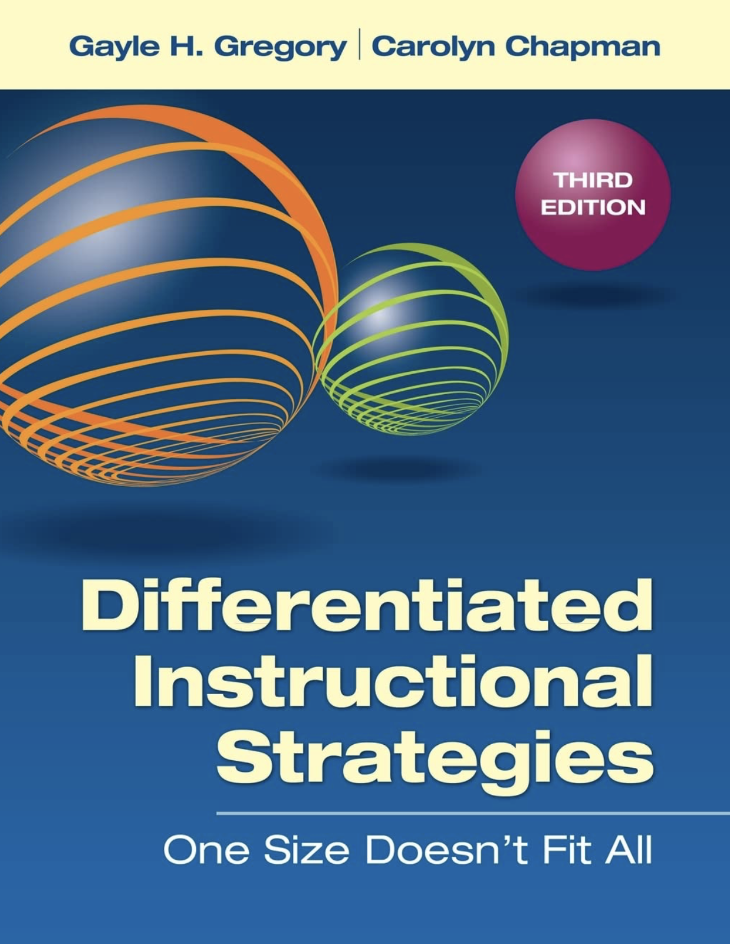
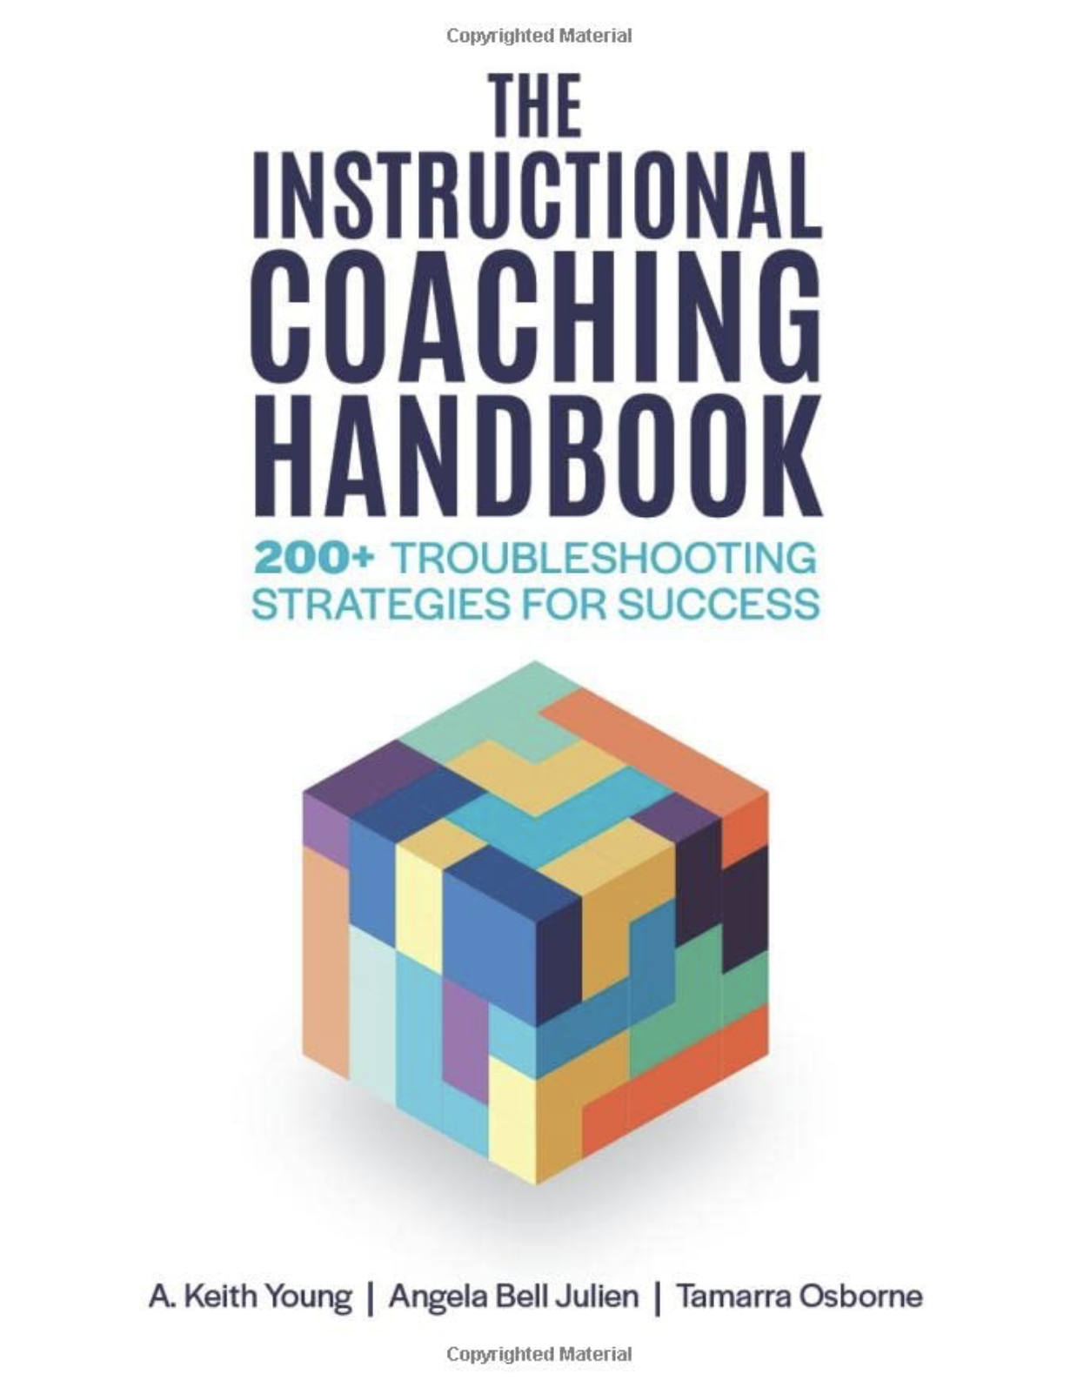
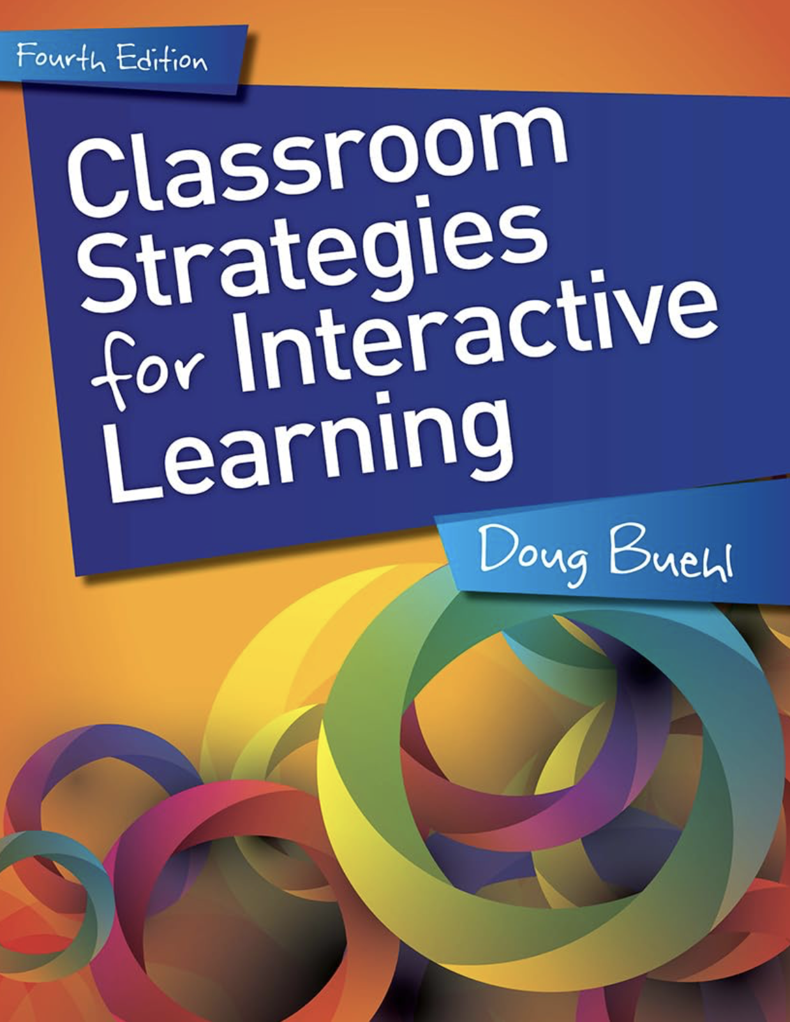
Strategies and Processing
Strategies → Processing → Connecting → Meaning → Learning
Lecture
Hands On
Discussions
Creating Apps
Think – Pair – Share
Small Group Problem Solving
Write a summary (in your own words)
What “processing” occurs while students are engaging in these strategies?
Does this “processing” lead students to make connections that make meaning and that ultimately satisfies your course objectives?
Notes:
Halloween was invented in Ireland - 2,000 years to the Celtic Samhain (SAH-win) festival: usher in “the dark half of the year.”

Slide 46
PROCESSING
`
Retrieved Relevant Prior Knowledge
Made Meaning of the Statement
Evaluated the Statement
Edited the Statement, as Needed
Indicated the Judgement
Retrieved Previous Judgement & Rationale
Organized an Explanation
Expressed the Explanation
Read Your Colleague for Understanding
Re-Generate a Response & Re-Express
Listen to Other’s Response
Make Meaning of their Response
Ask Questions, as Needed
Compare Self and Other’s Meanings
Generate Response and Respond
Meaning
Learning
Think-Pair-Share
Anticipation Guide

Slide 47
Implementation matters.
Active Learning is not magic.

Slide 48
Make Some Meaning
Write a 1-sentence summary of this Strategies & Processing section.

Slide 49
Active Learning: Closure

Slide 50
Closure
What are two take aways from today’s workshop?

Slide 51
Active Learning
Teach Forward
Objectives Strategies Processing Connecting Meaning Learning
Plan Backward
What we process we learn.
Notes:
Halloween was invented in Ireland - 2,000 years to the Celtic Samhain (SAH-win) festival: usher in “the dark half of the year.”

Slide 52
Active Learning
Experience ‣ Knowledge ‣ Meaning
Peter Doolittle
Educational Psychology
Virginia Tech
pdoo@vt.edu
Institutional Research and
Academic Career Development
Workshop

